Slide 1
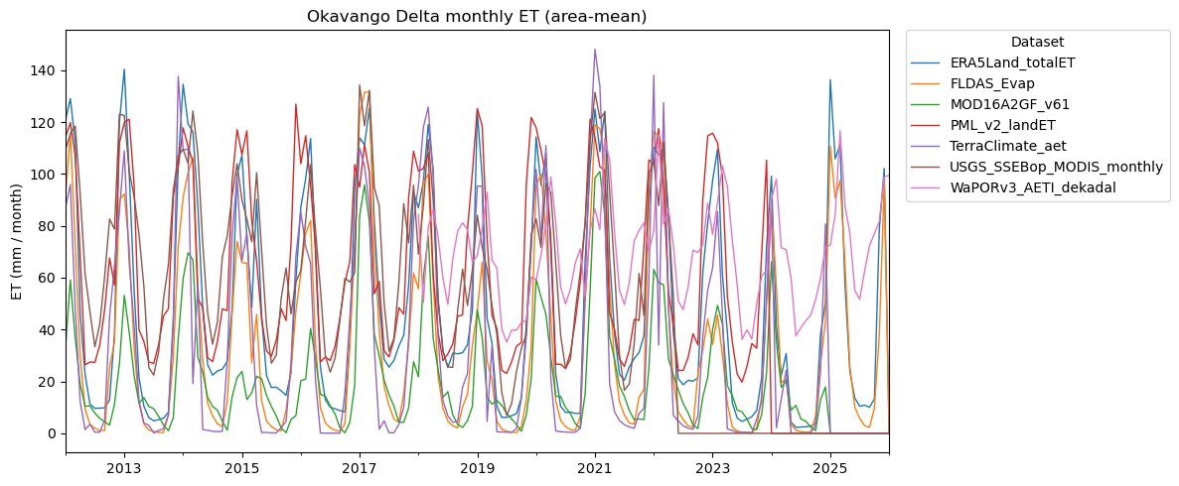
Water budget: ET model comparison (datasets in GEE)

Slide 2
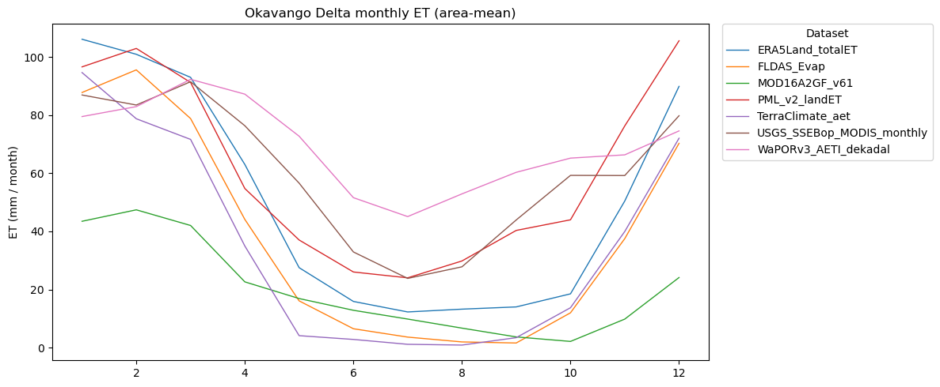

Slide 3
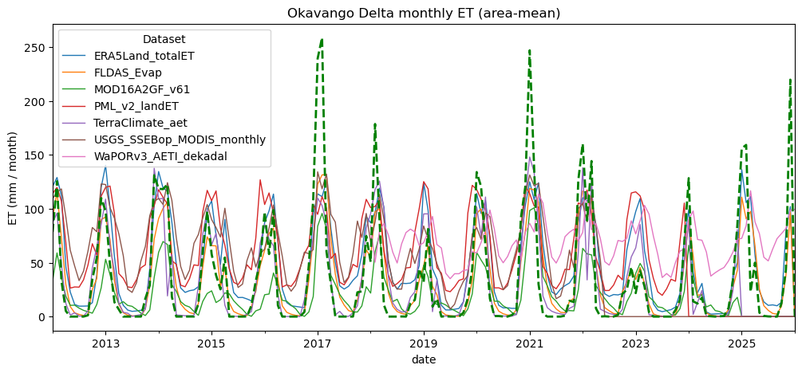

Slide 4
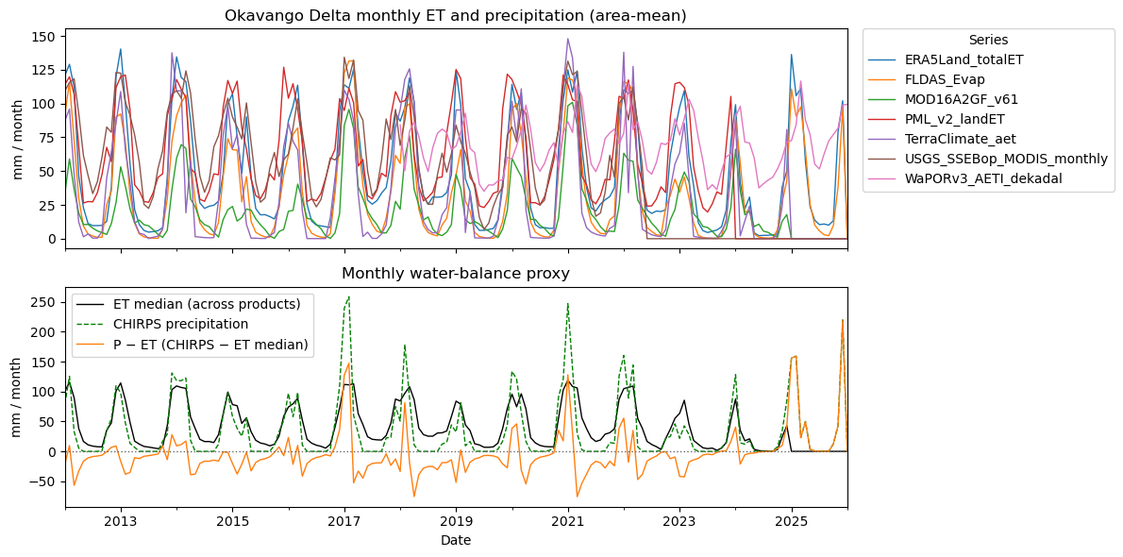

Slide 5
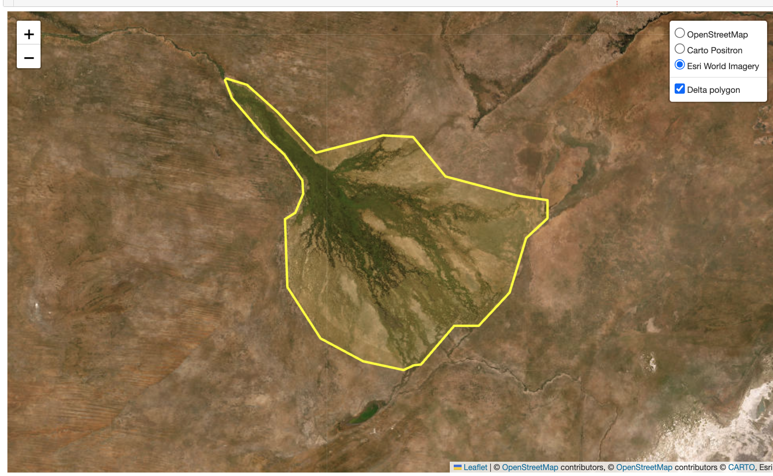

Slide 6
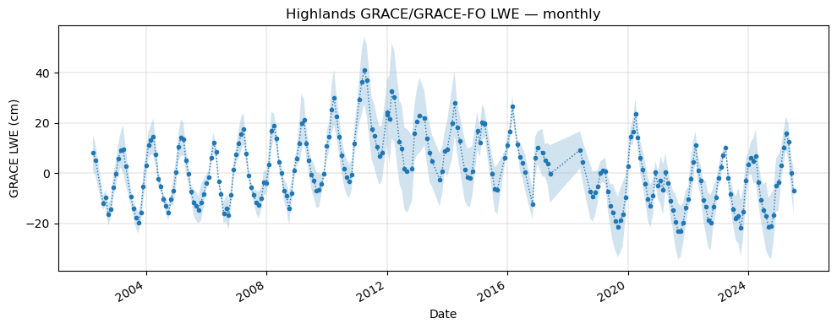
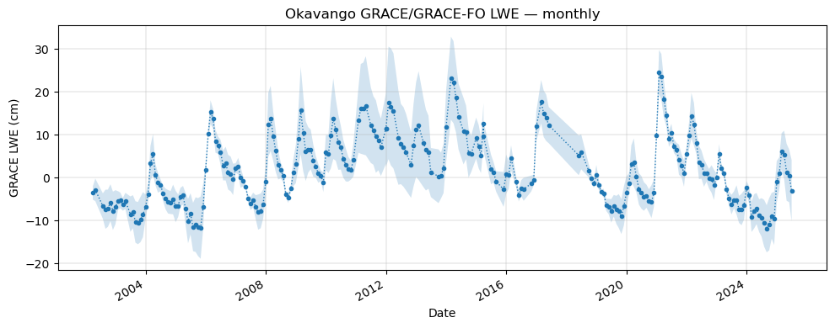

Slide 7
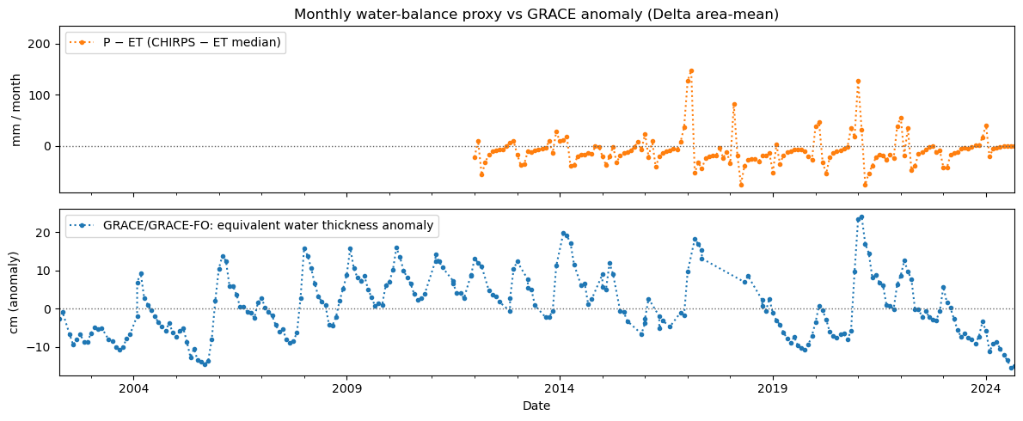

Slide 8
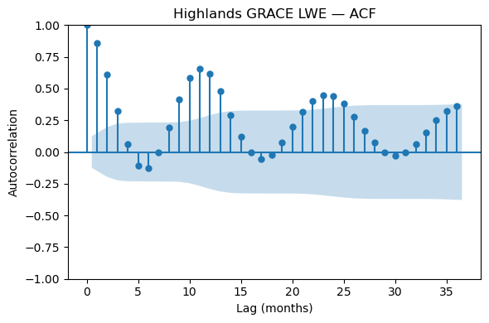
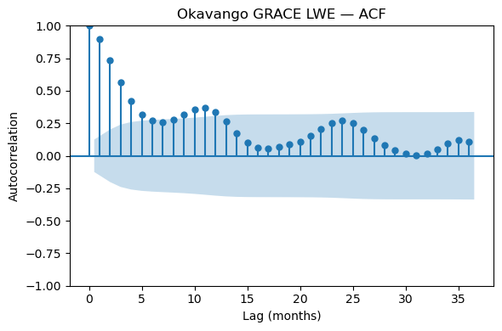
Which Kirchner study?

Slide 9
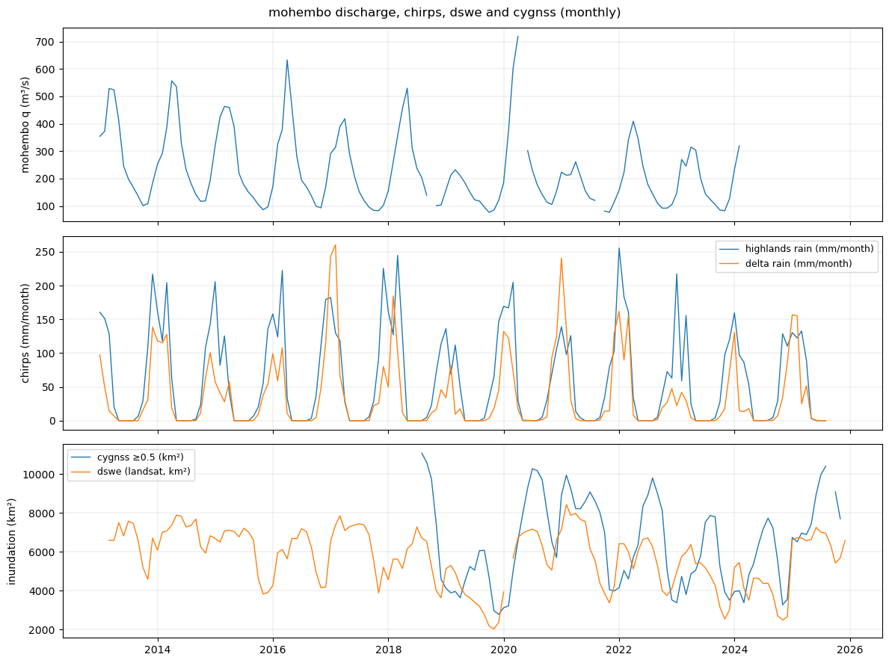

Slide 10
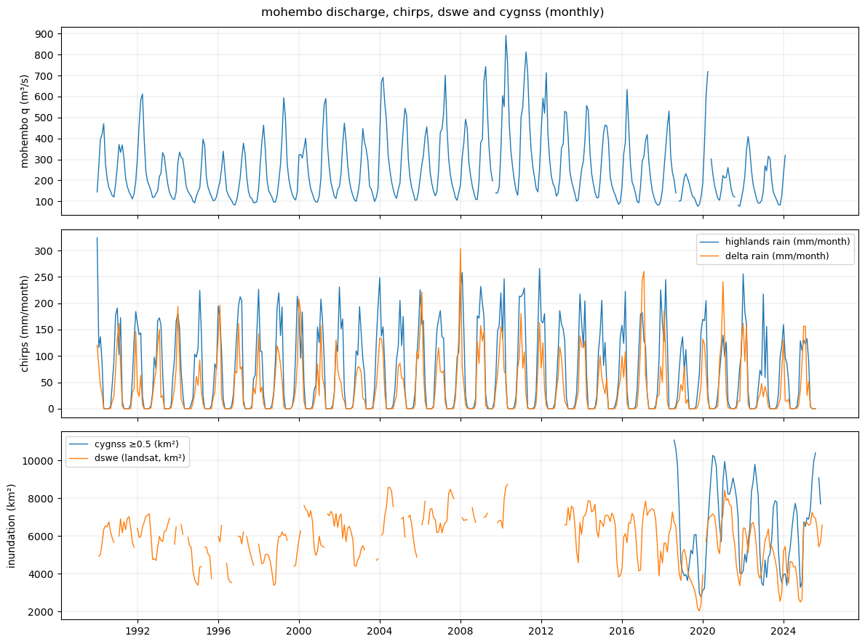

Slide 11
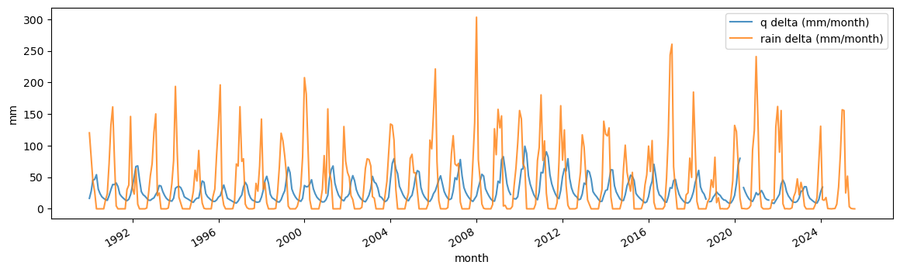

Slide 12
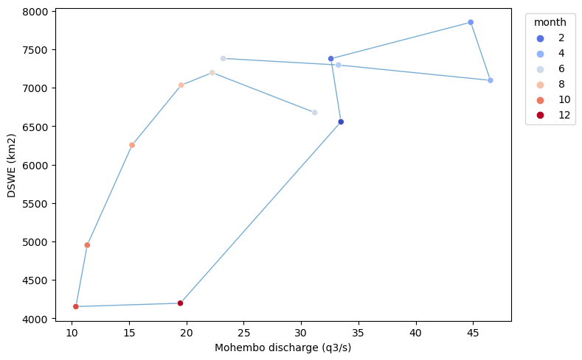
2016-2017
Hysterestis by categories.

Slide 13
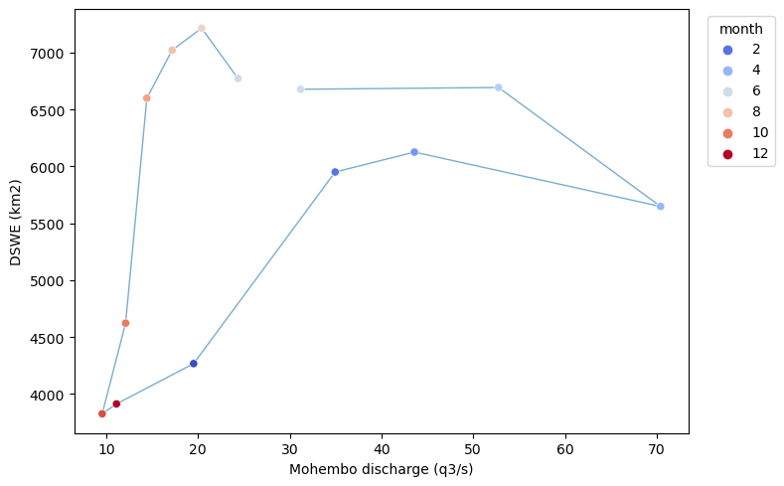
2015-2016

Slide 14
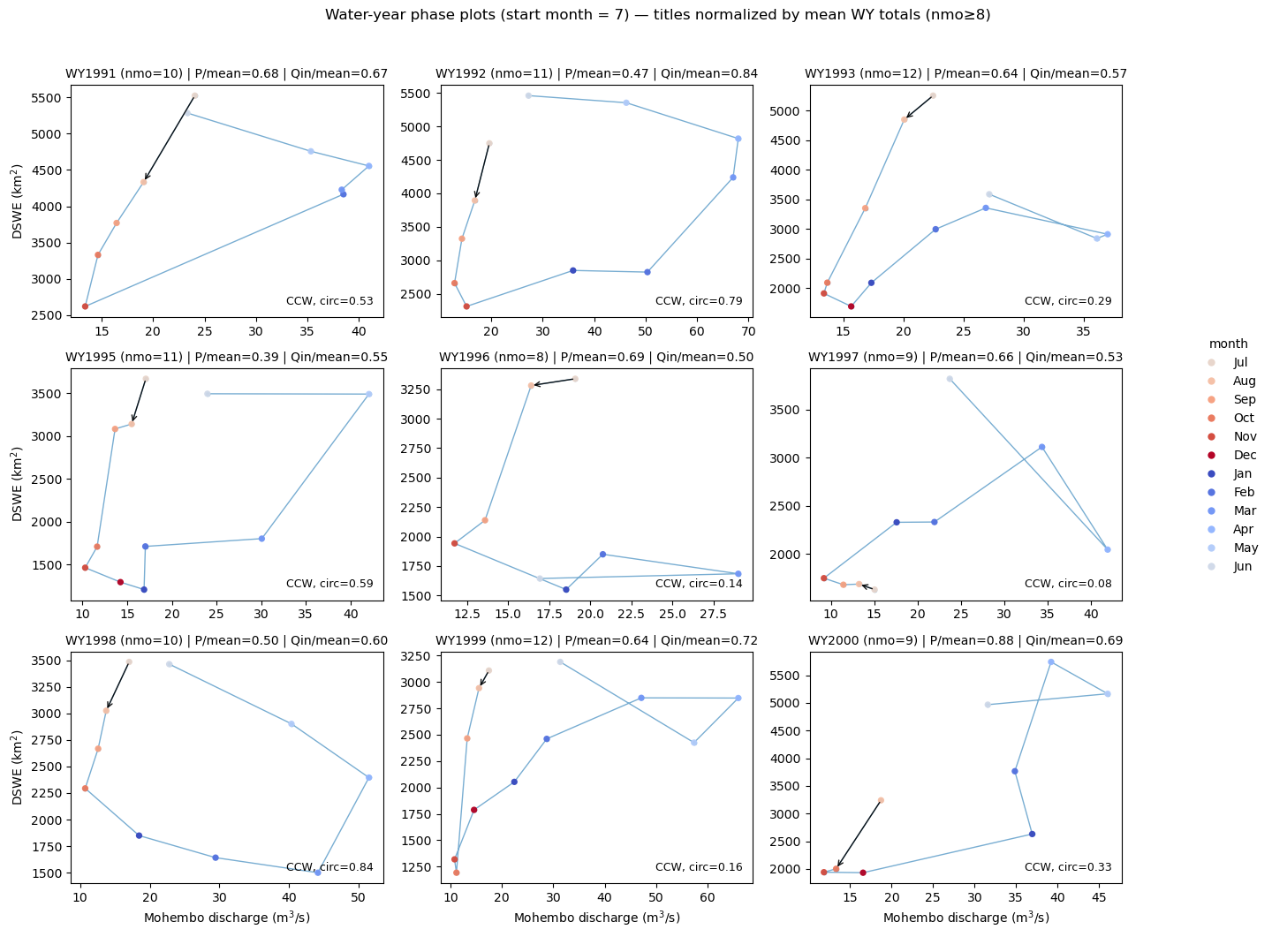

Slide 15
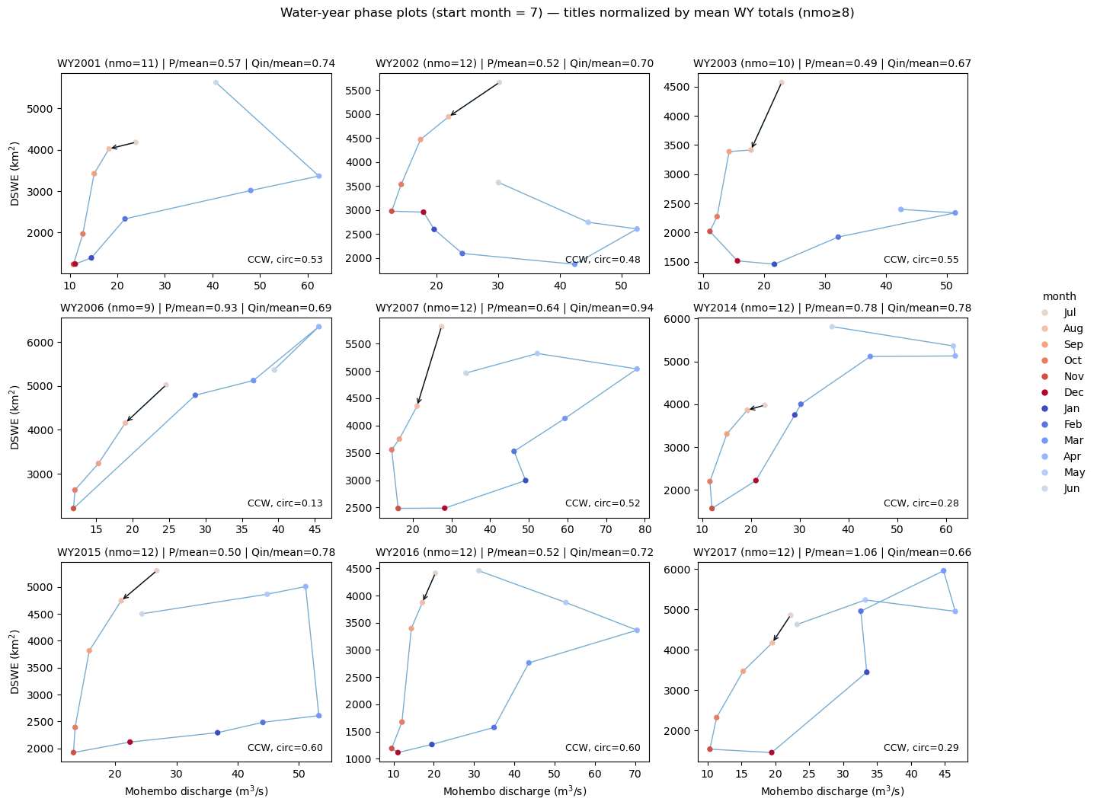

Slide 16
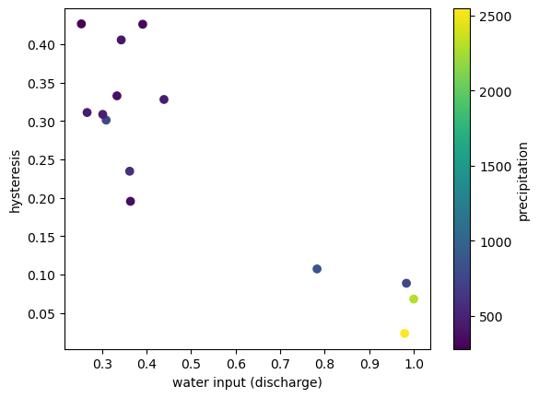
DSWE > 0

Slide 17
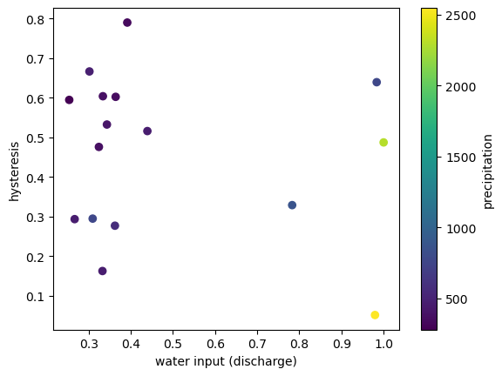
DSWE > 1

Slide 18
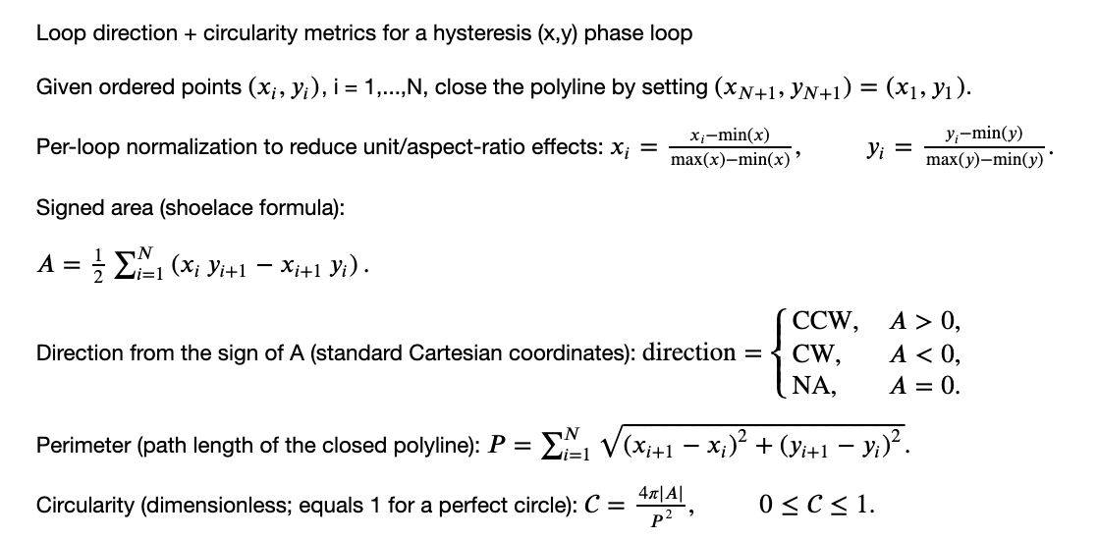

Slide 19
Hysteresis overview
Developed hysteresis metric using shoelace formula to measure loopiness of discharge-inundation loops
Metric normalized by perimeter captures circularity of relationship
Most years show counterclockwise orientation with approximately four clockwise instances (cause unclear)
Flood extent lags discharge in most years, with significant floodplain storage during recession
Drier years show more hysteresis than wetter years, appearing threshold-dependent rather than linear
Piotr emphasized that antecedent year conditions strongly determine inundation patterns
Pre-wetting from decent rainfall causes the flood to spread much faster. TODO: rate of flood spread.
Measured 90% infiltration to the floodplain with only 10% retention in some cases
Laurel L noted connectivity phenomenon where marshy areas remain disconnected from main channels in dry years
TODO: examine antecedent conditions more carefully and adjust water year calculation

Slide 20
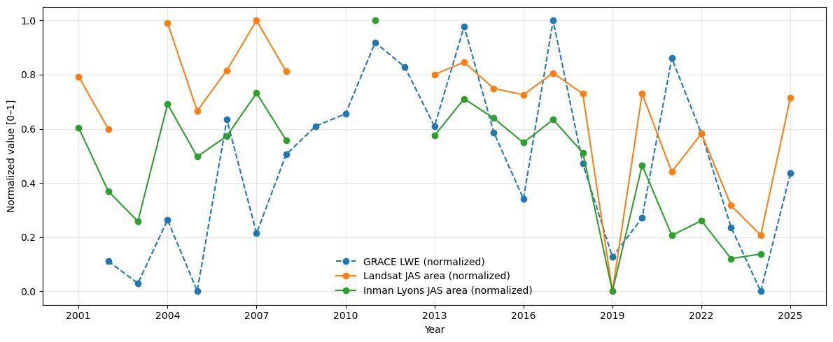
The agreement looks much better in some years than others.
Notes:
TODO: look at each Okavango and Highland cell on it’s own (assuming each cell is highly correlated with it’s neighbor - need to check)

Slide 21
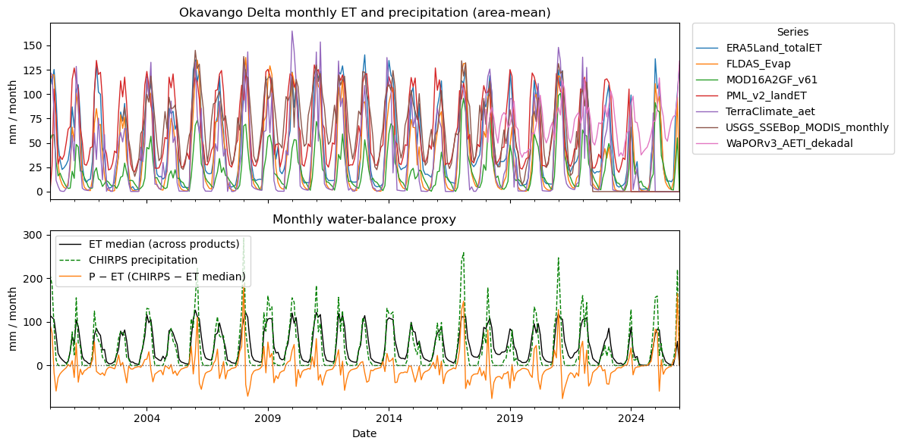

Slide 22
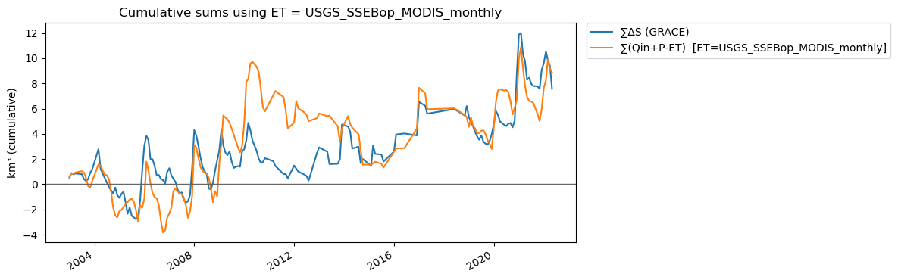
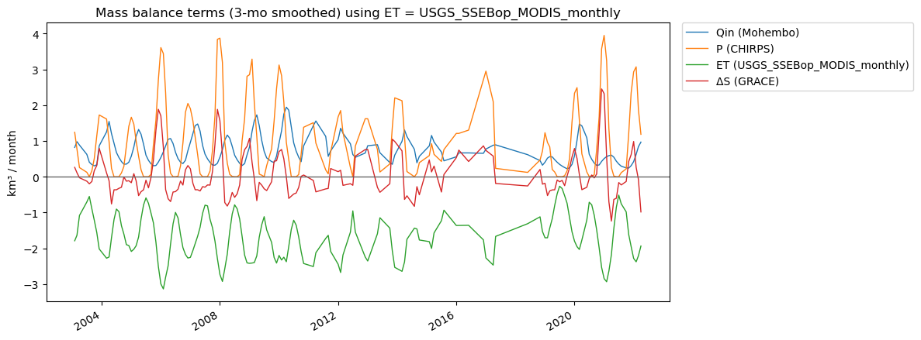

Slide 23
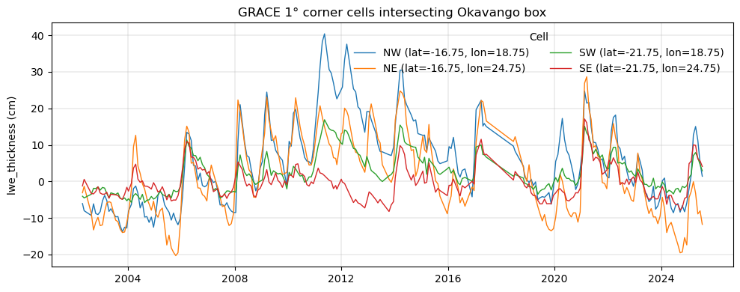
GRACE JPL RL06.3 CRI netCDF

Slide 24
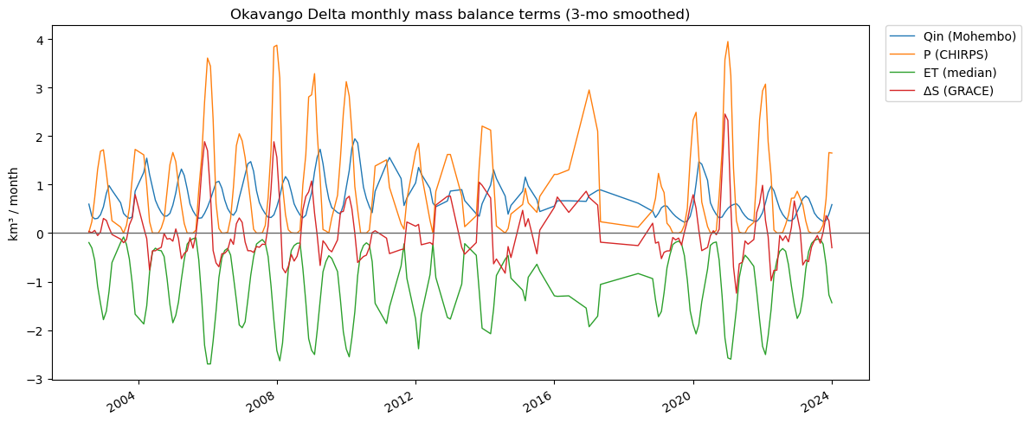
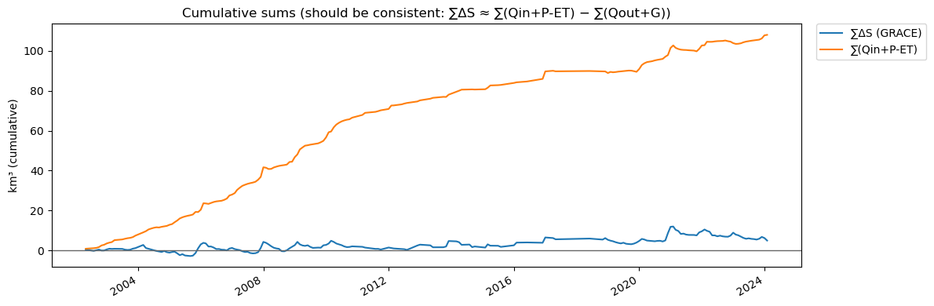

Slide 25
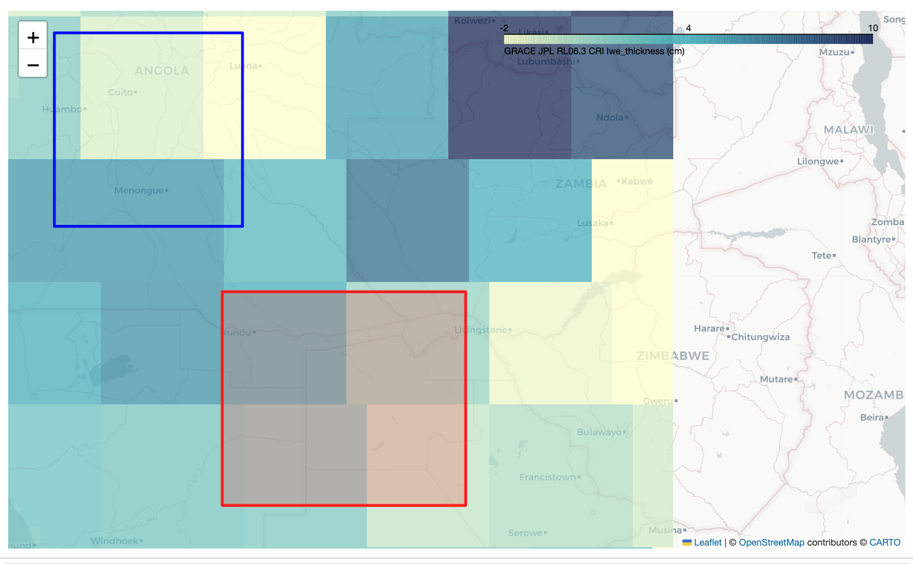

Slide 26
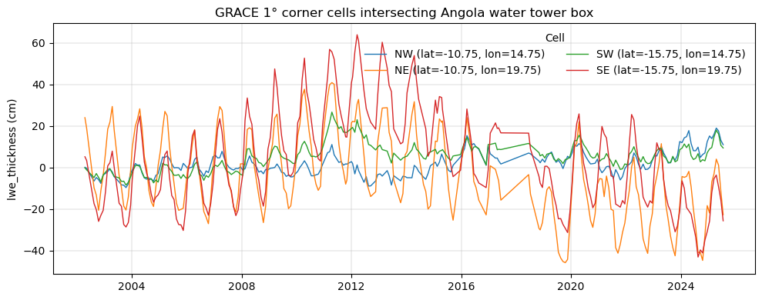

Slide 27
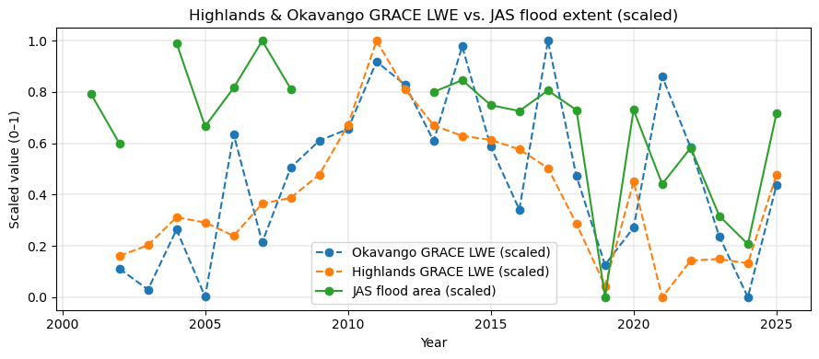

Slide 28
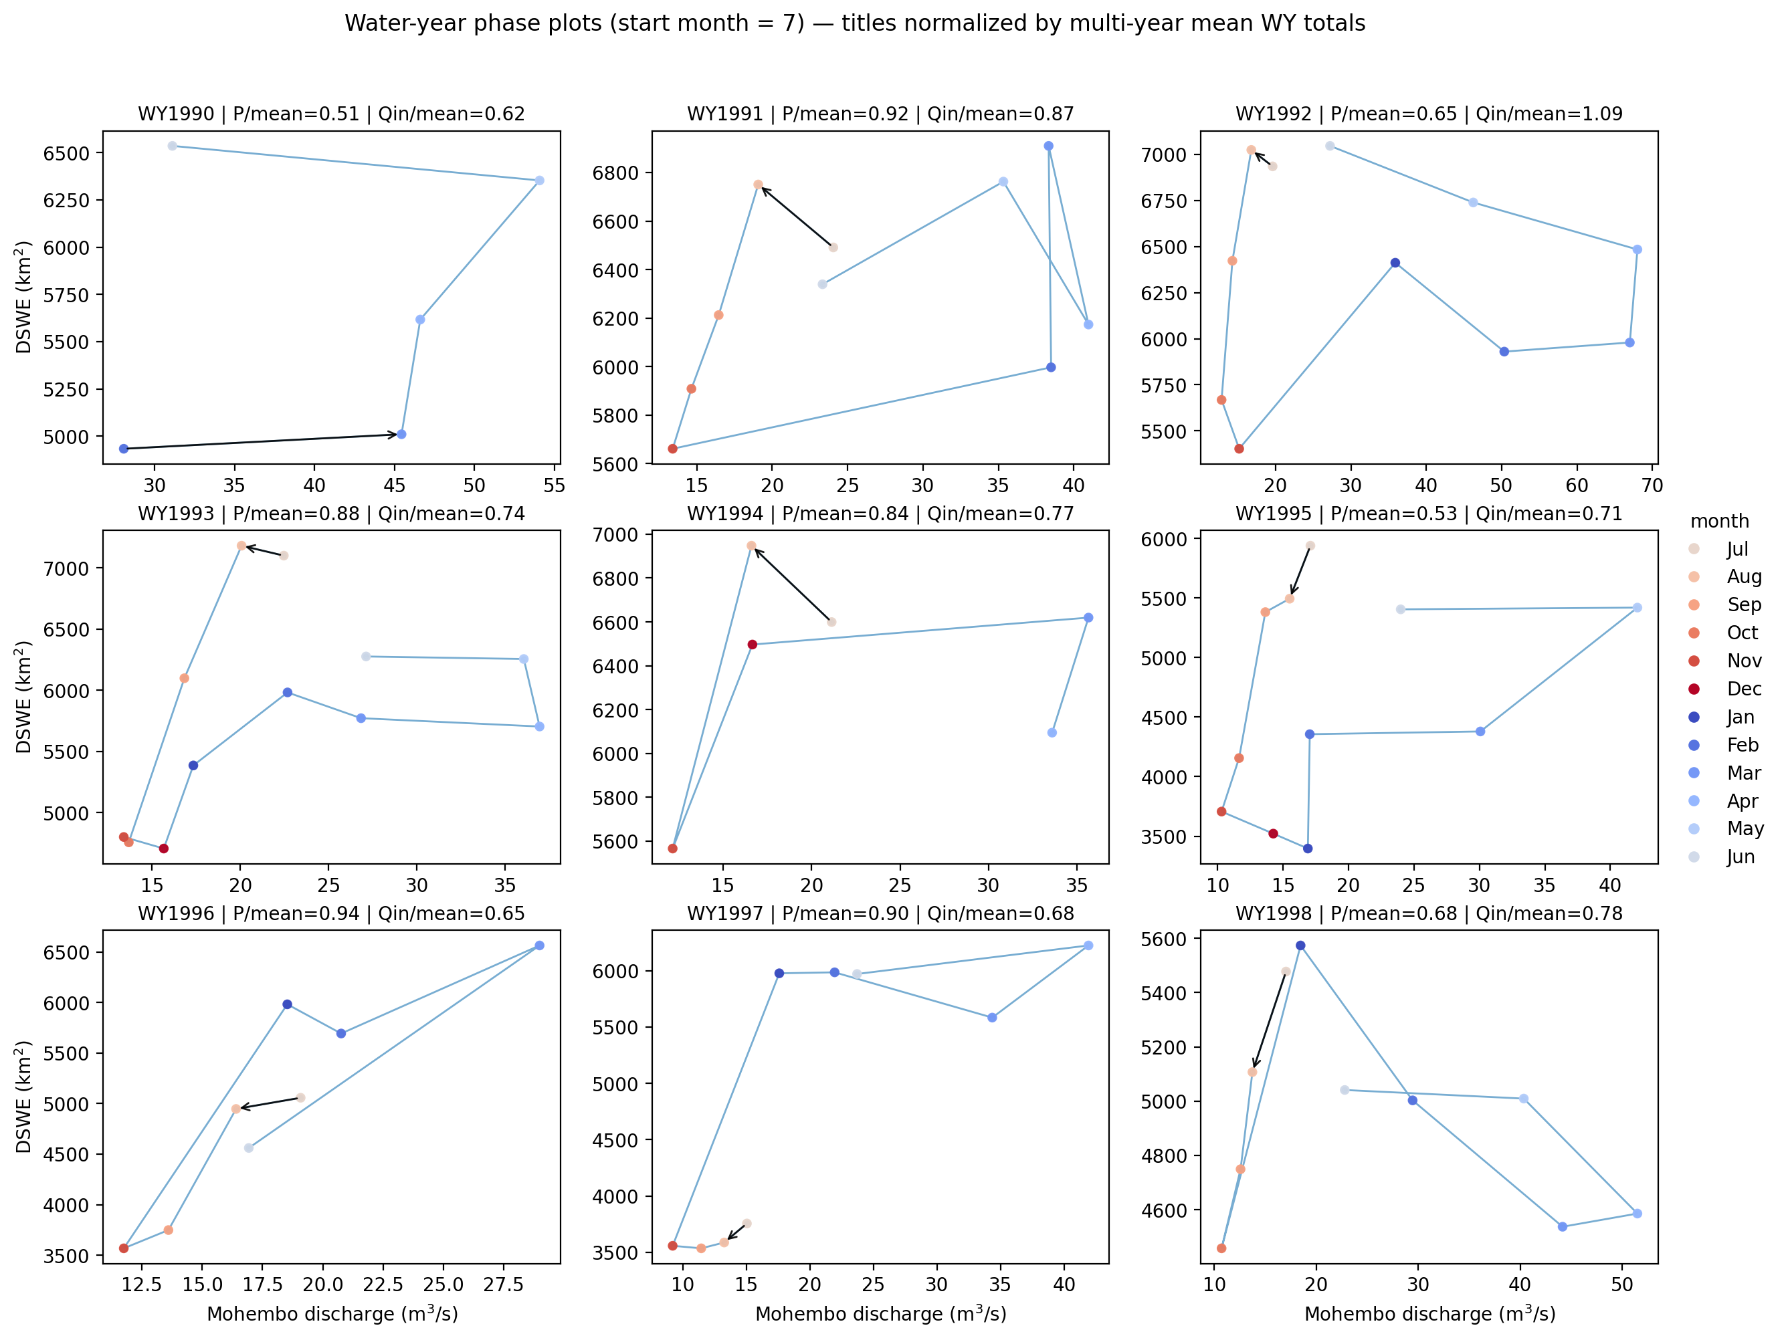

Slide 29
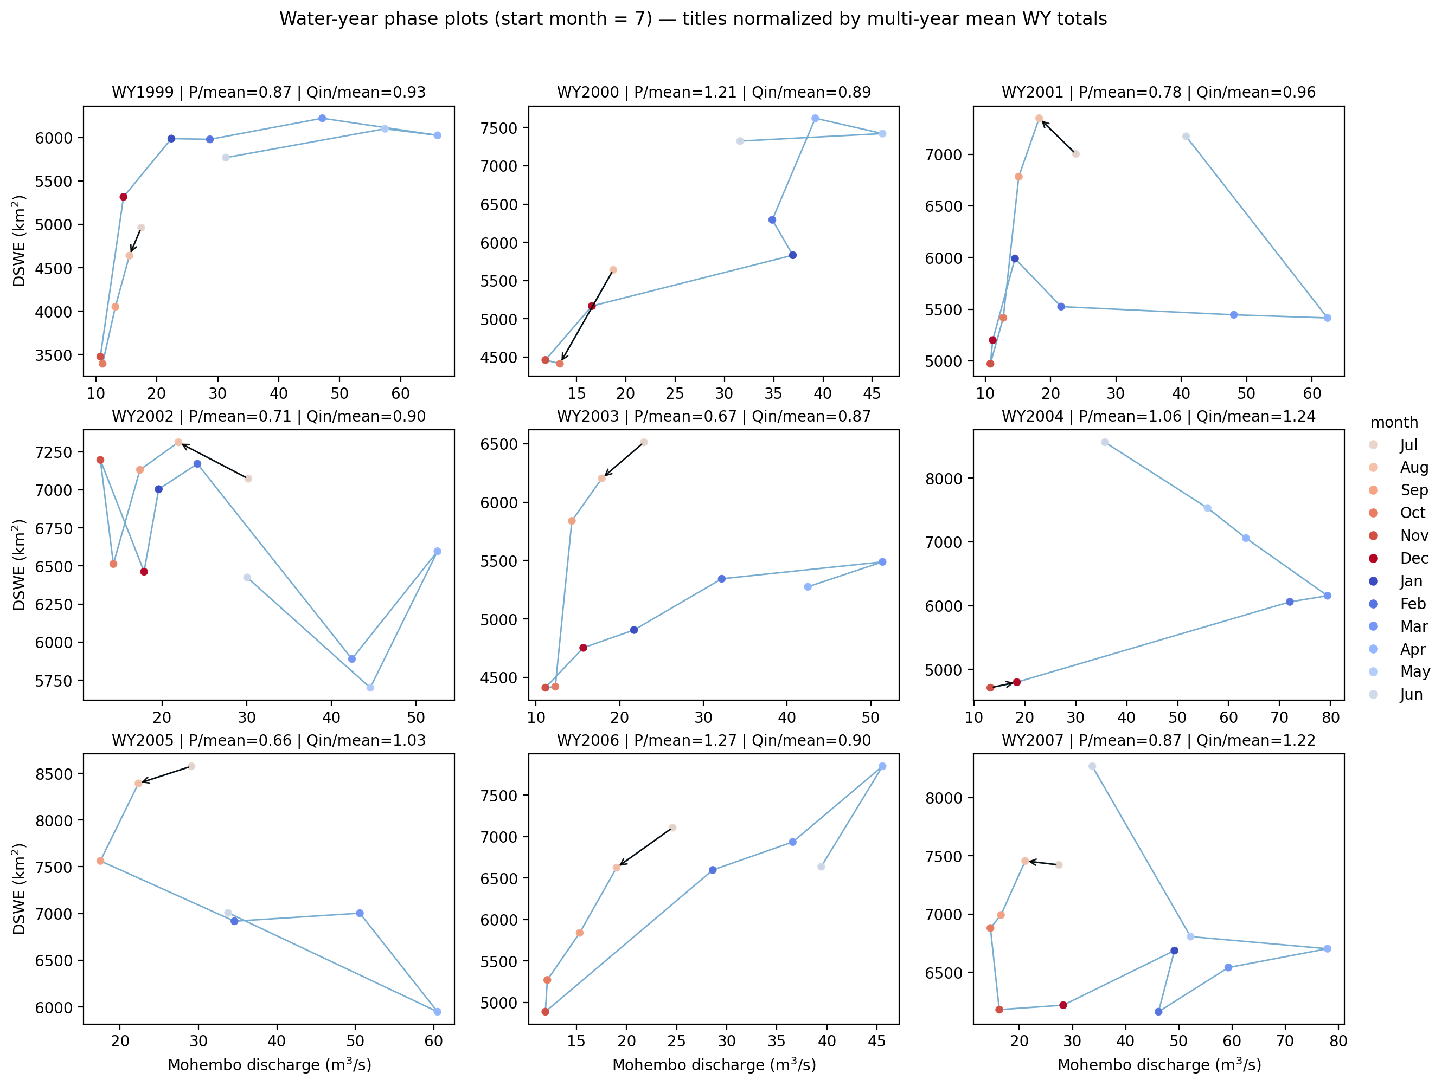

Slide 30
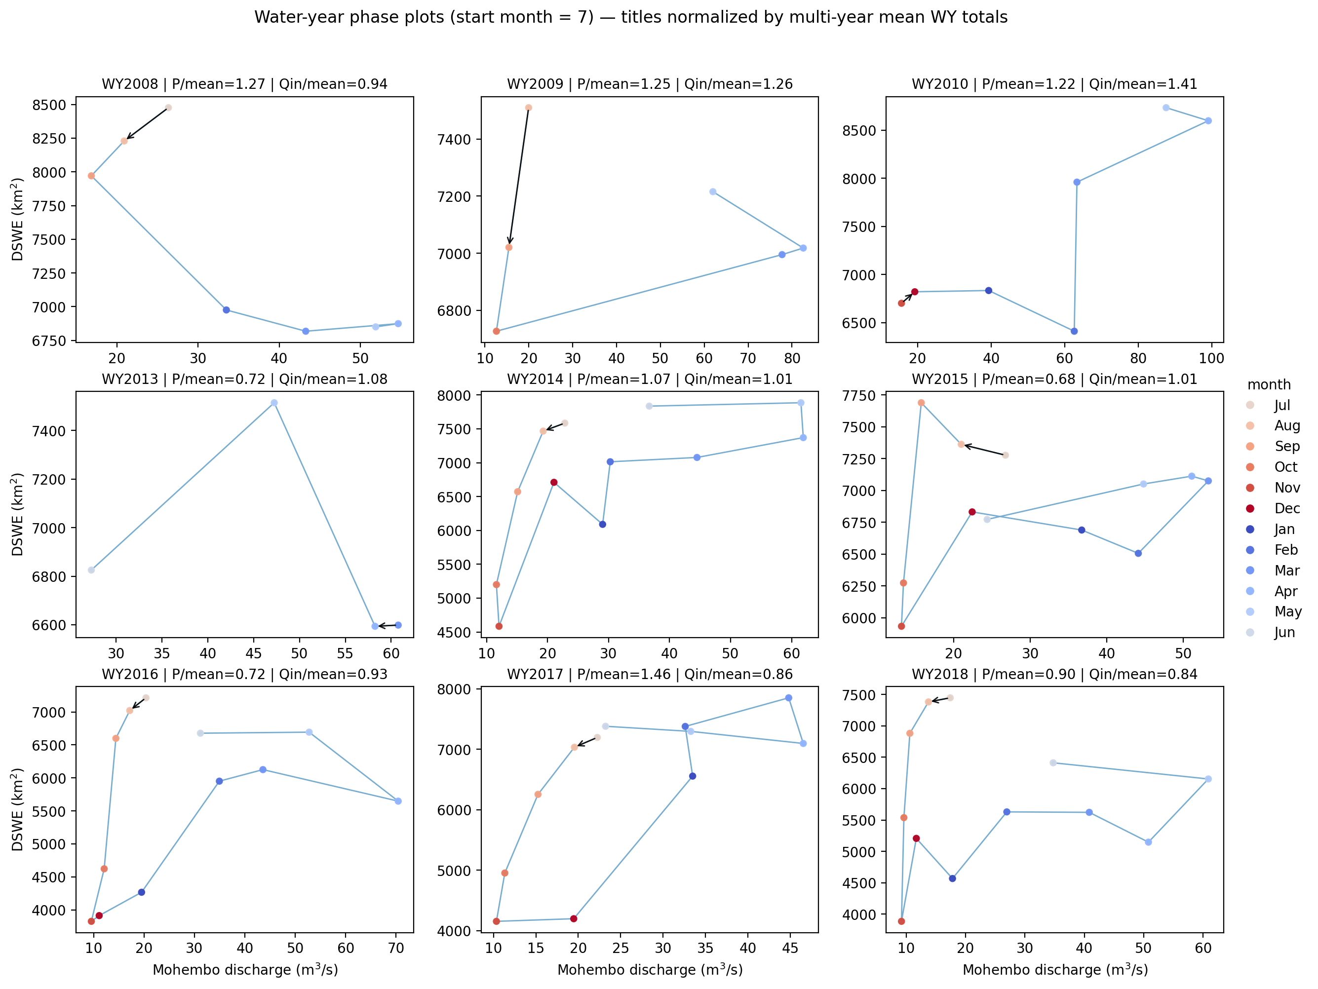

Slide 31
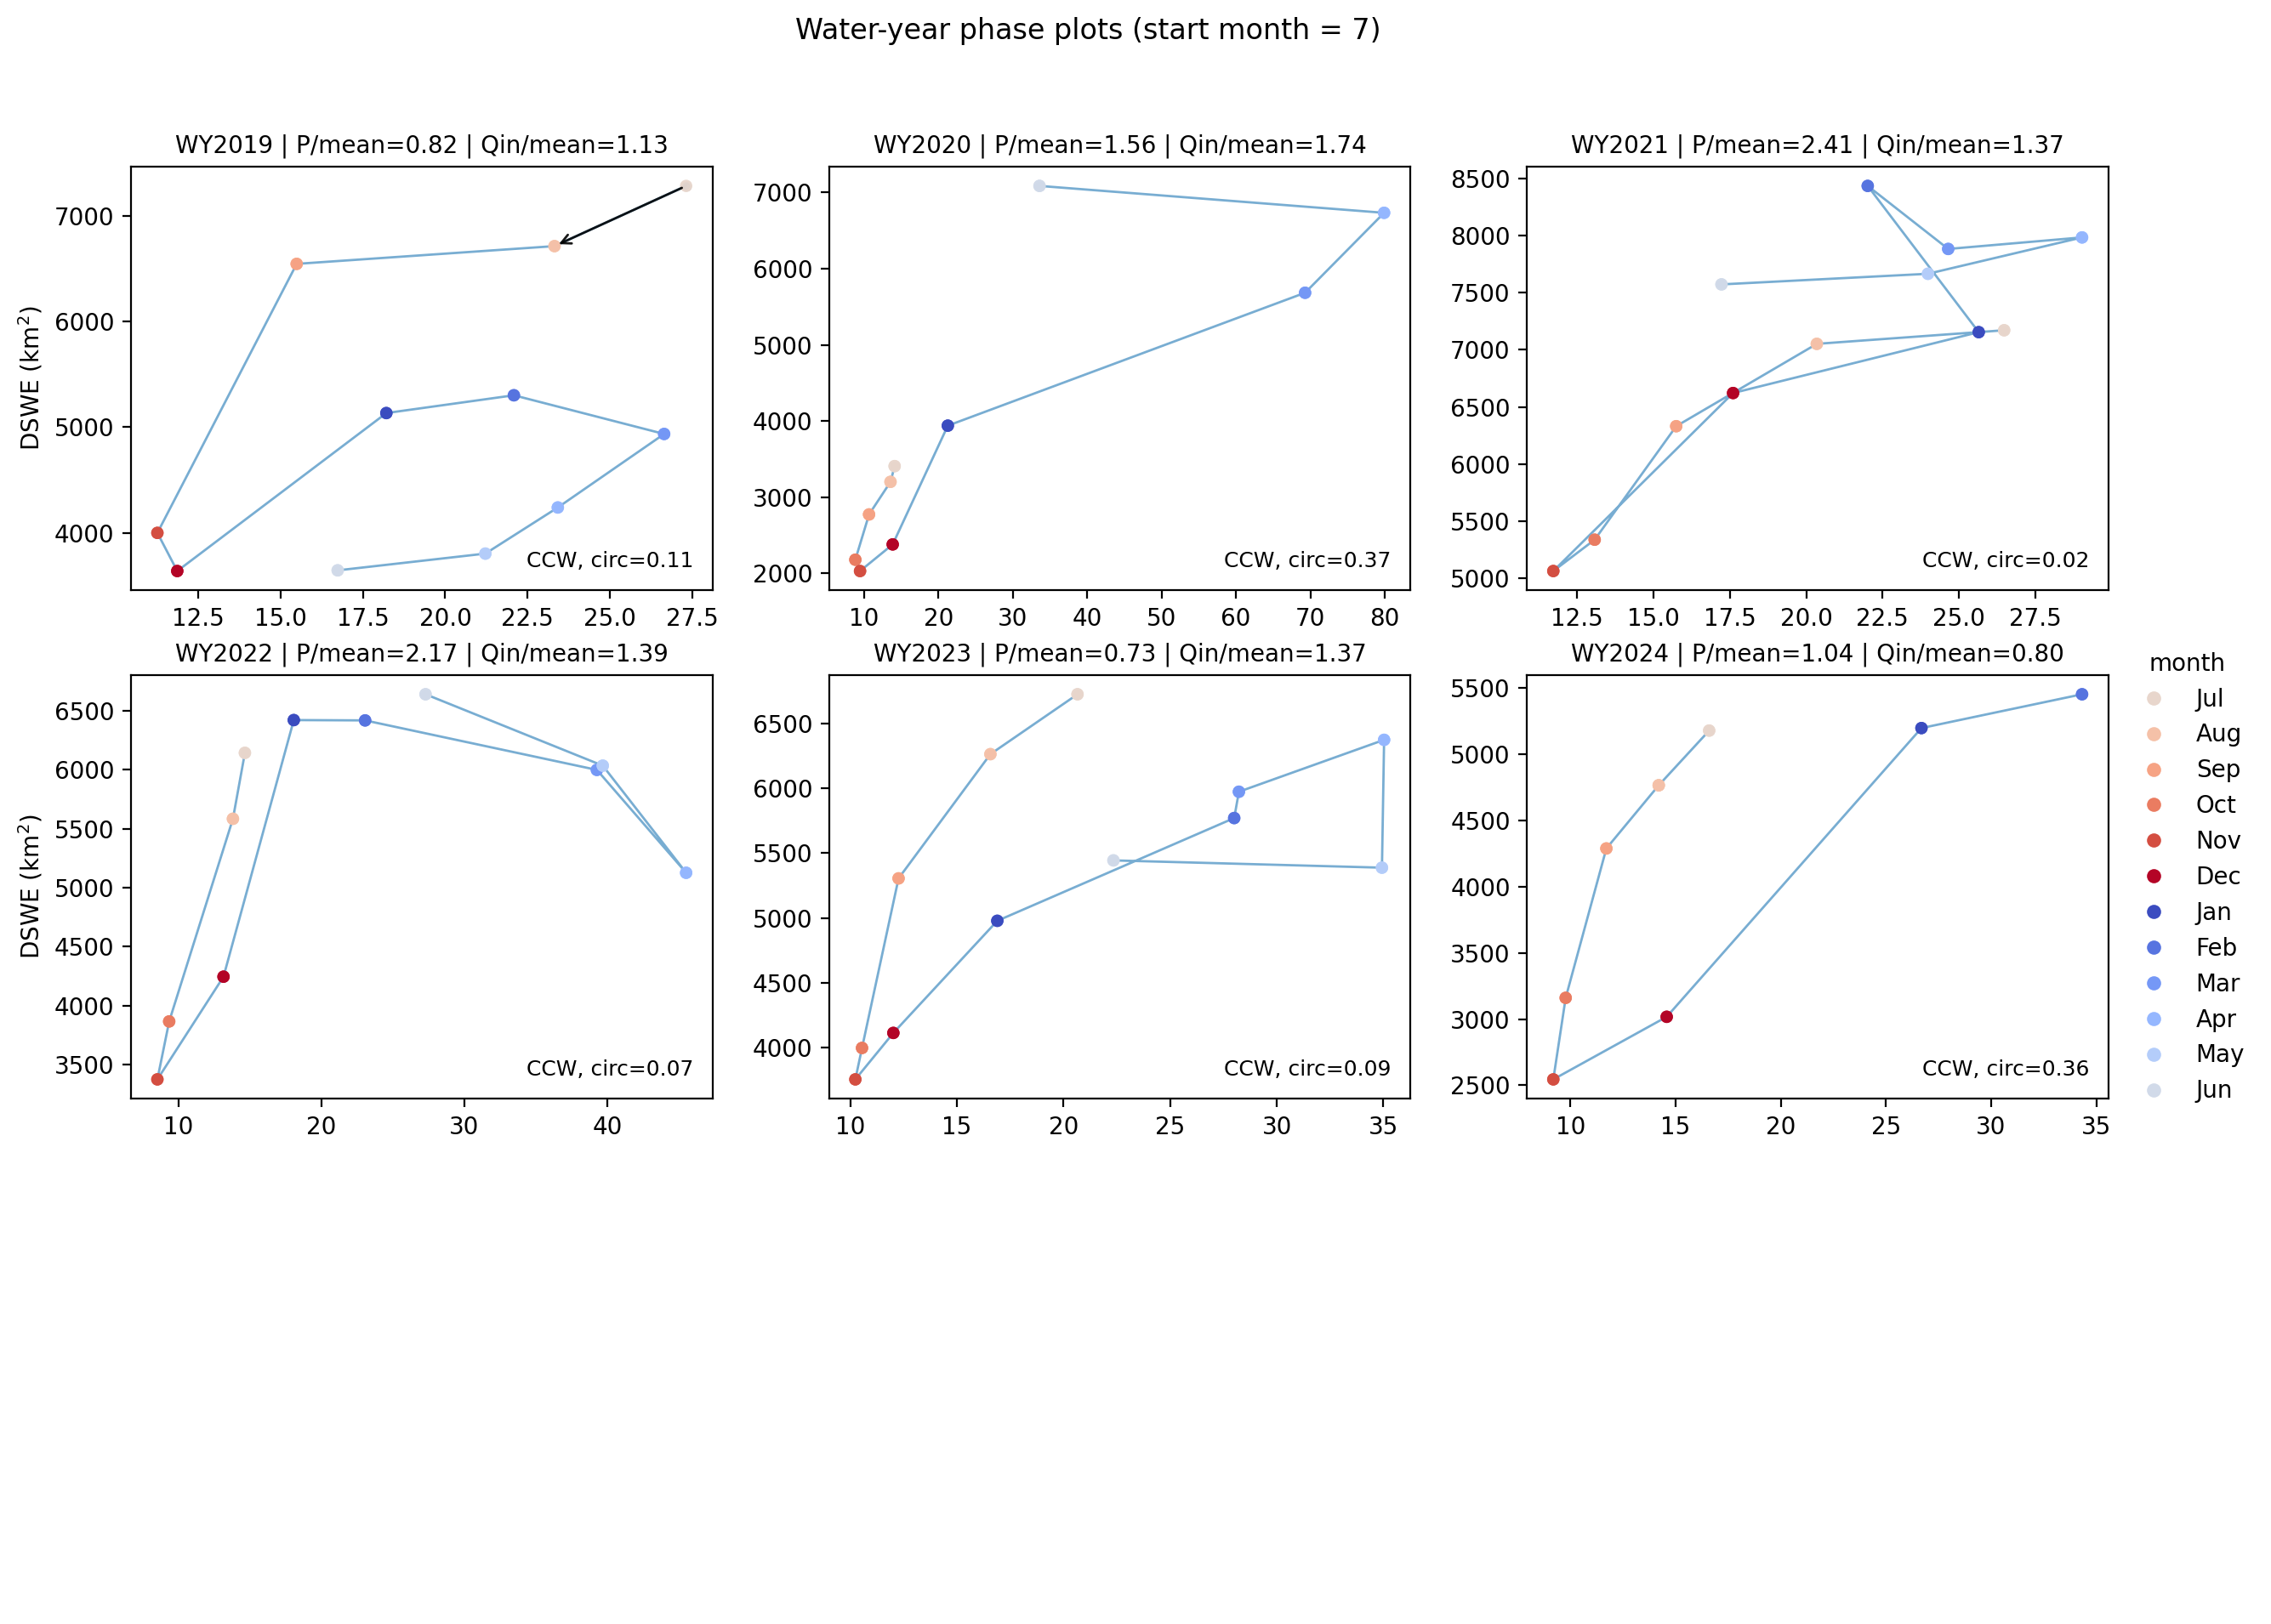

Slide 32
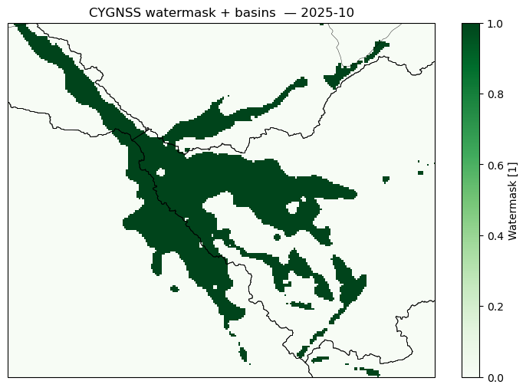
Notes:
WWF/HydroSHEDS/v1/Basins/hybas_4
https://developers.google.com/earth-engine/datasets/catalog/WWF_HydroSHEDS_v1_Basins_hybas_4

Slide 33
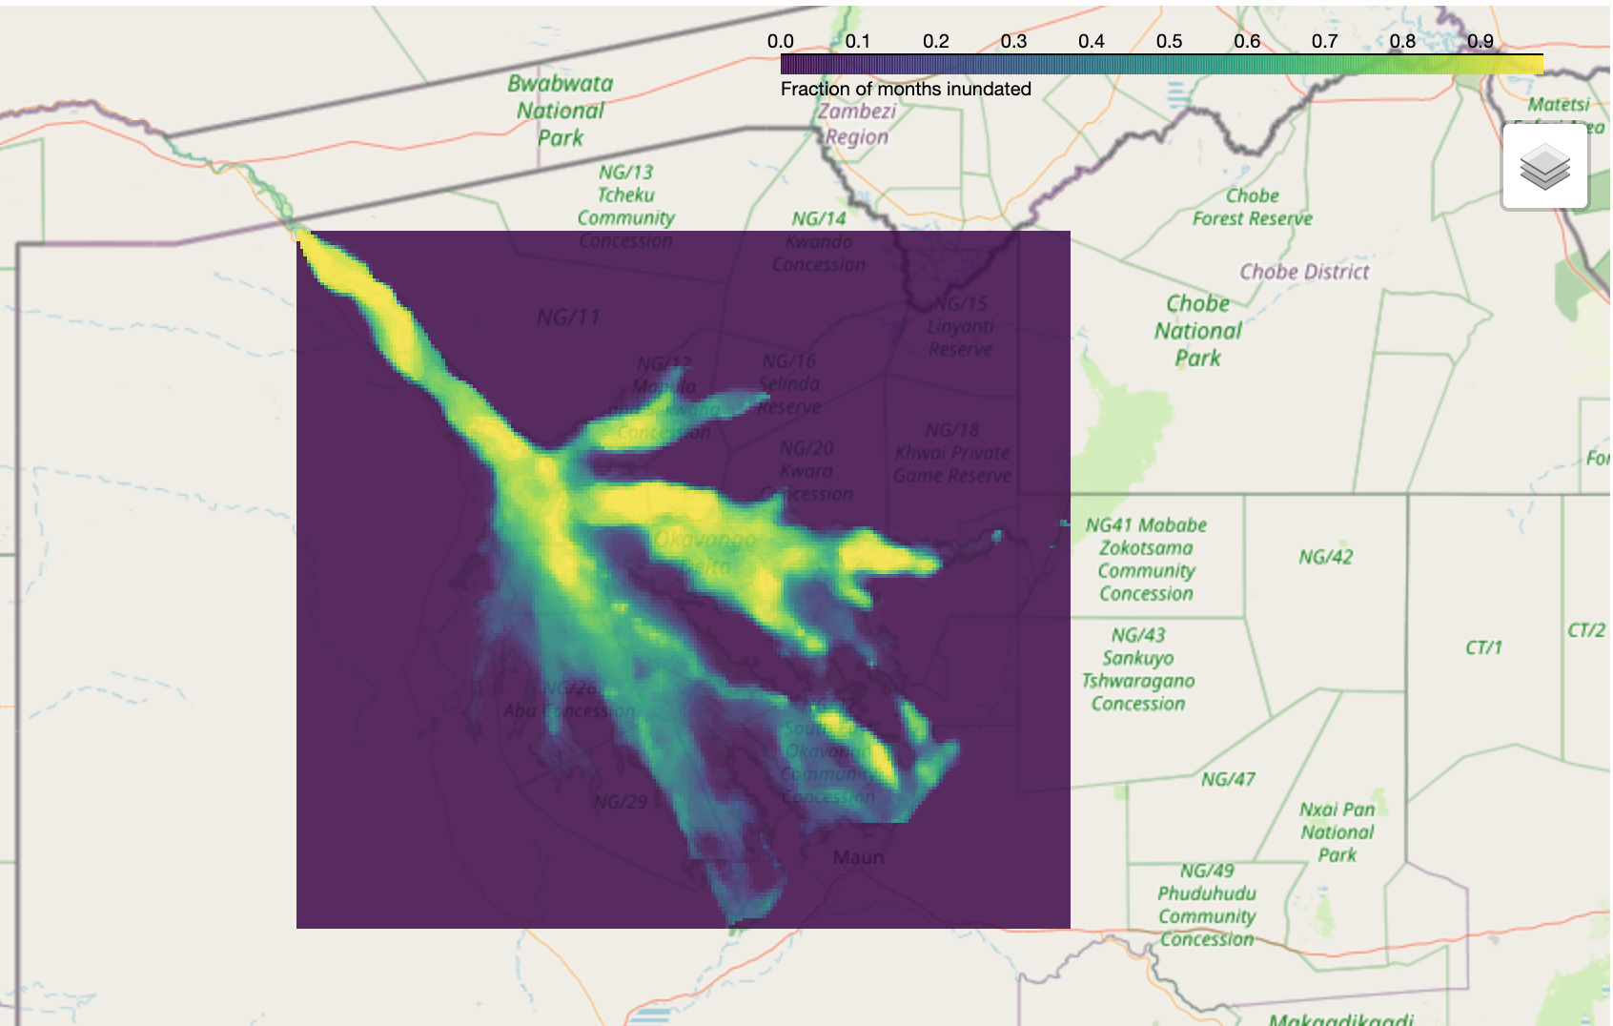
Notes:
CYGNSS…

Slide 34
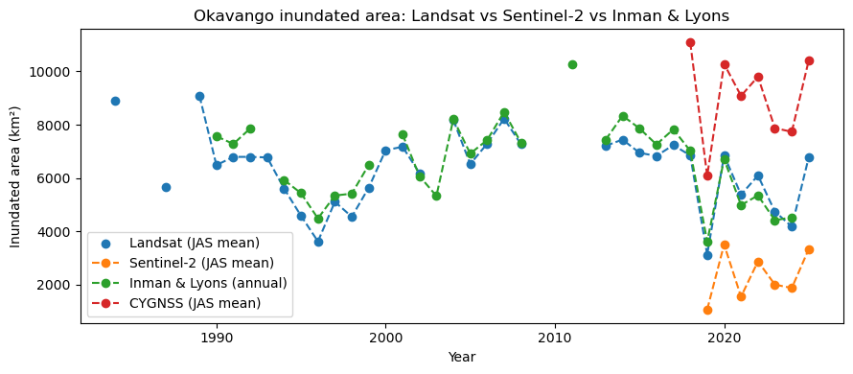

Slide 35
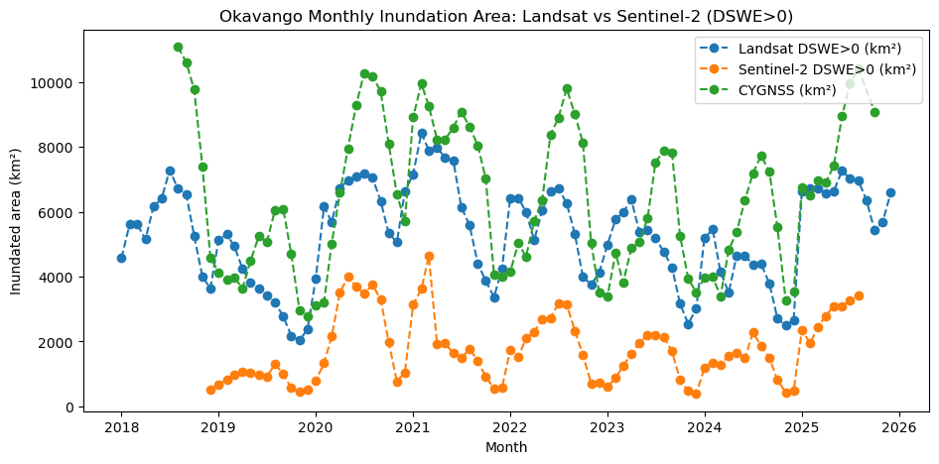

Slide 36
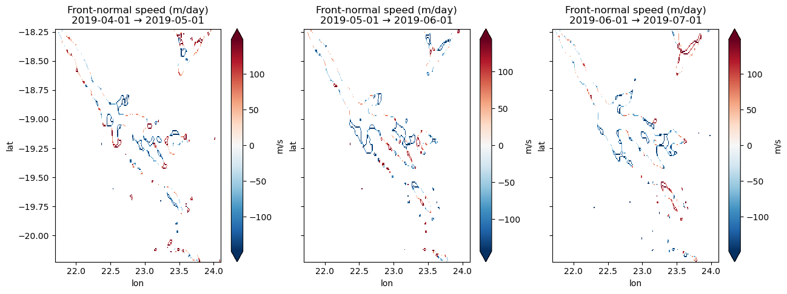

Slide 37
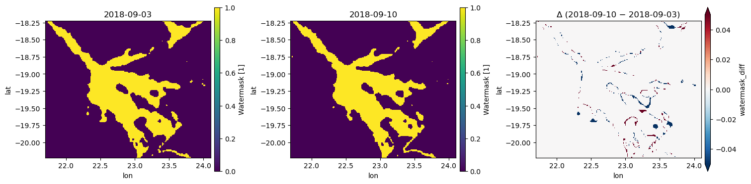

Slide 38
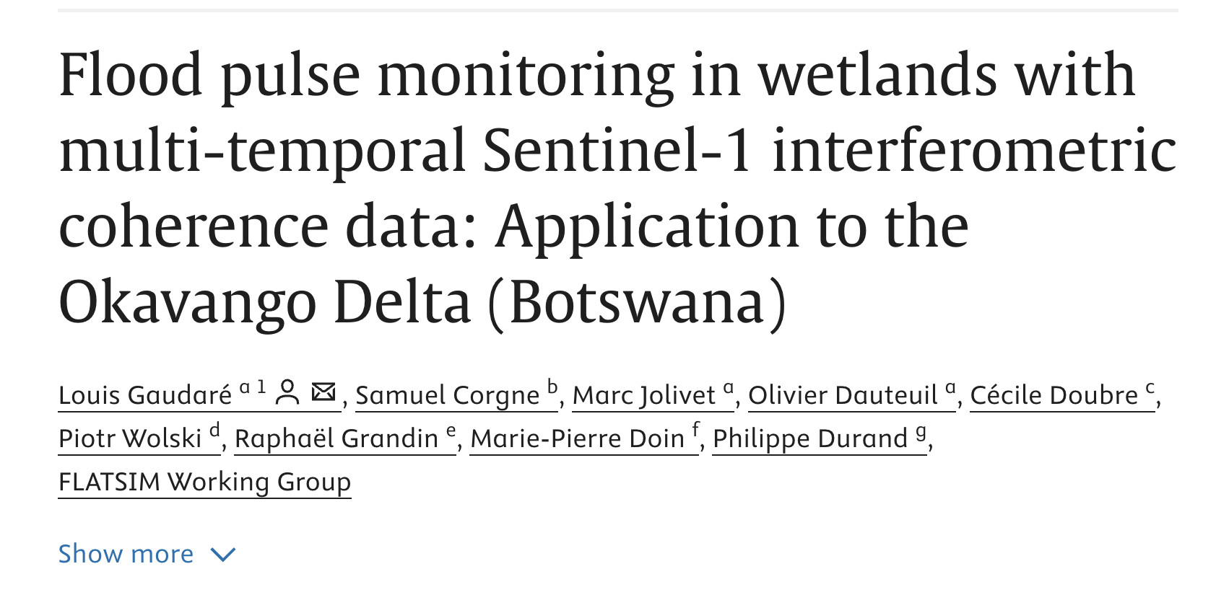

Slide 39
Miscellaneous
All of the stations in grdc dataset
Why is CYNSS >> DSWE in ~ September (towards end of flood pulse?)

Slide 40
Miscellaneous
All of the stations in grdc dataset
Why is CYNSS >> DSWE in ~ September (towards end of flood pulse?)

Slide 41
Miscellaneous
All of the stations in grdc dataset
Why is CYNSS >> DSWE in ~ September (towards end of flood pulse?)

Slide 42
Miscellaneous
All of the stations in grdc dataset
Why is CYNSS >> DSWE in ~ September (towards end of flood pulse?)

Slide 43
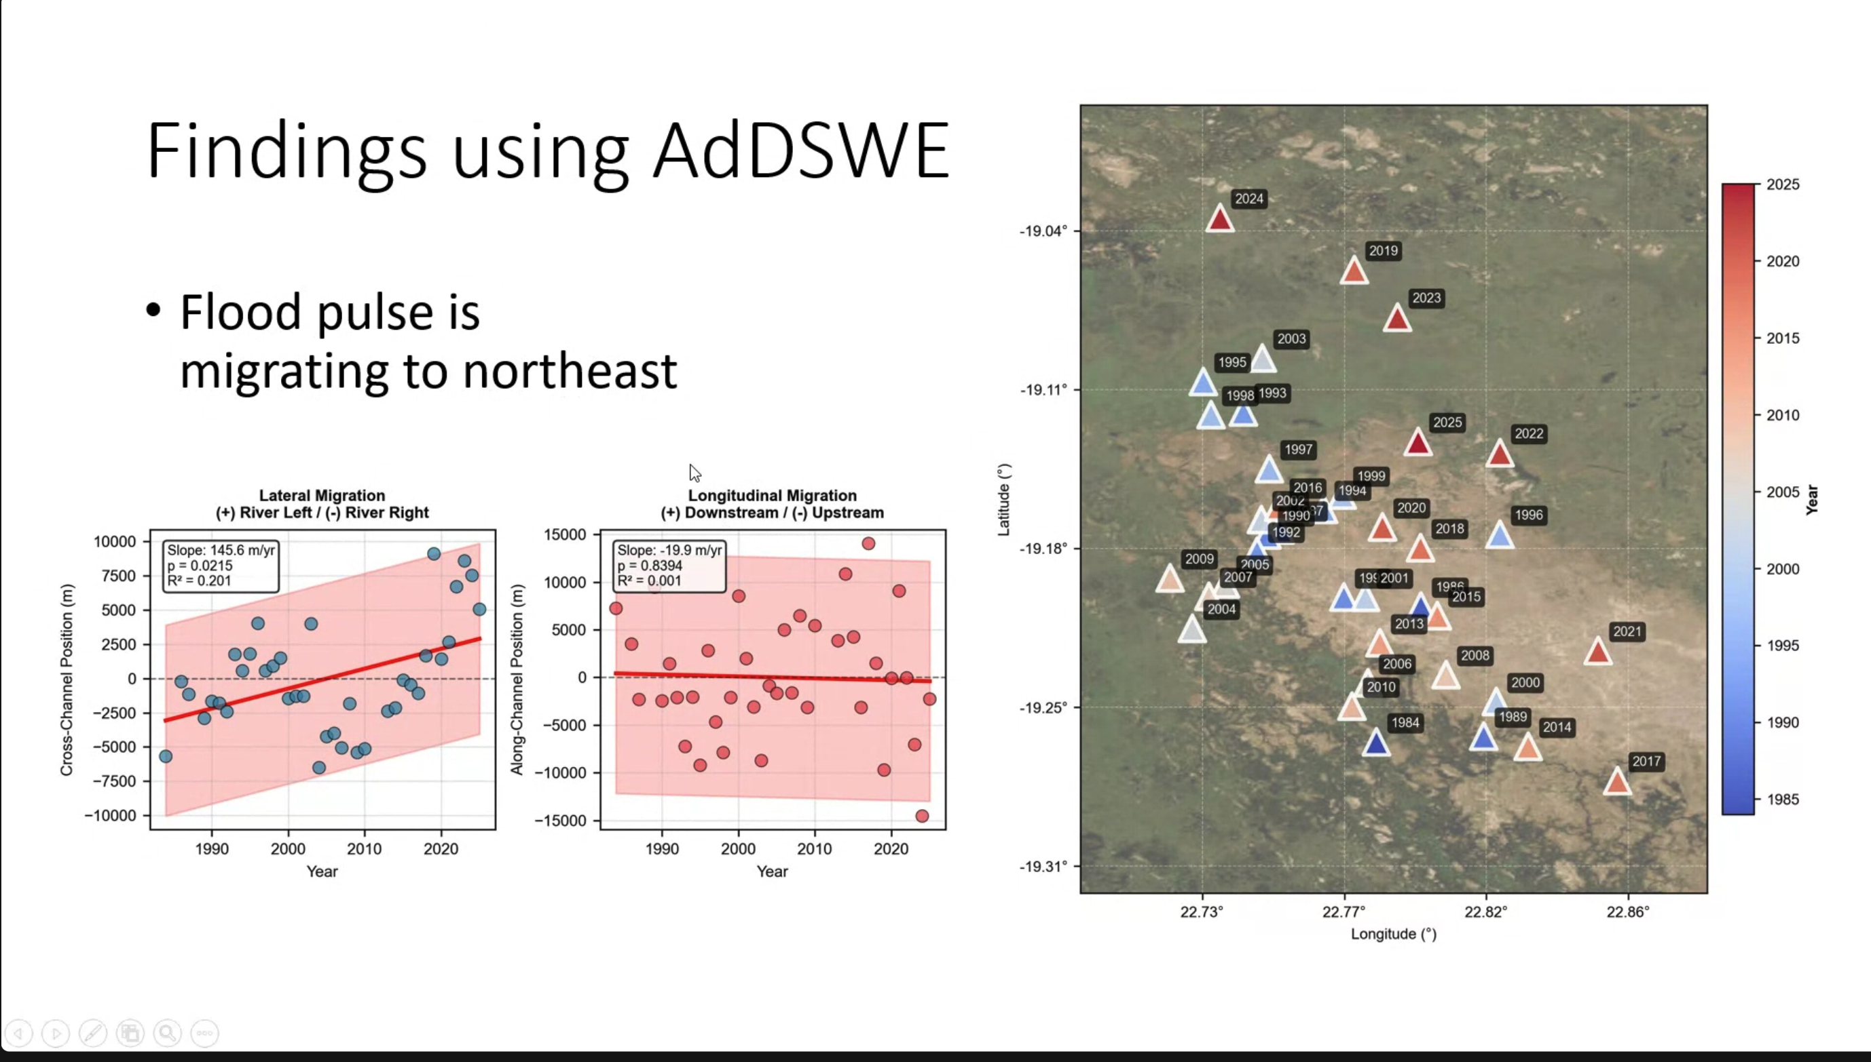

Slide 44
Agenda
Matt Clark
Grace
autocorrelation
correlation with precipitation, surface water, inflow
Shapefile airstrips
Transition matrix
Hysteresis
ET comparison / watershed mass balance

Slide 45
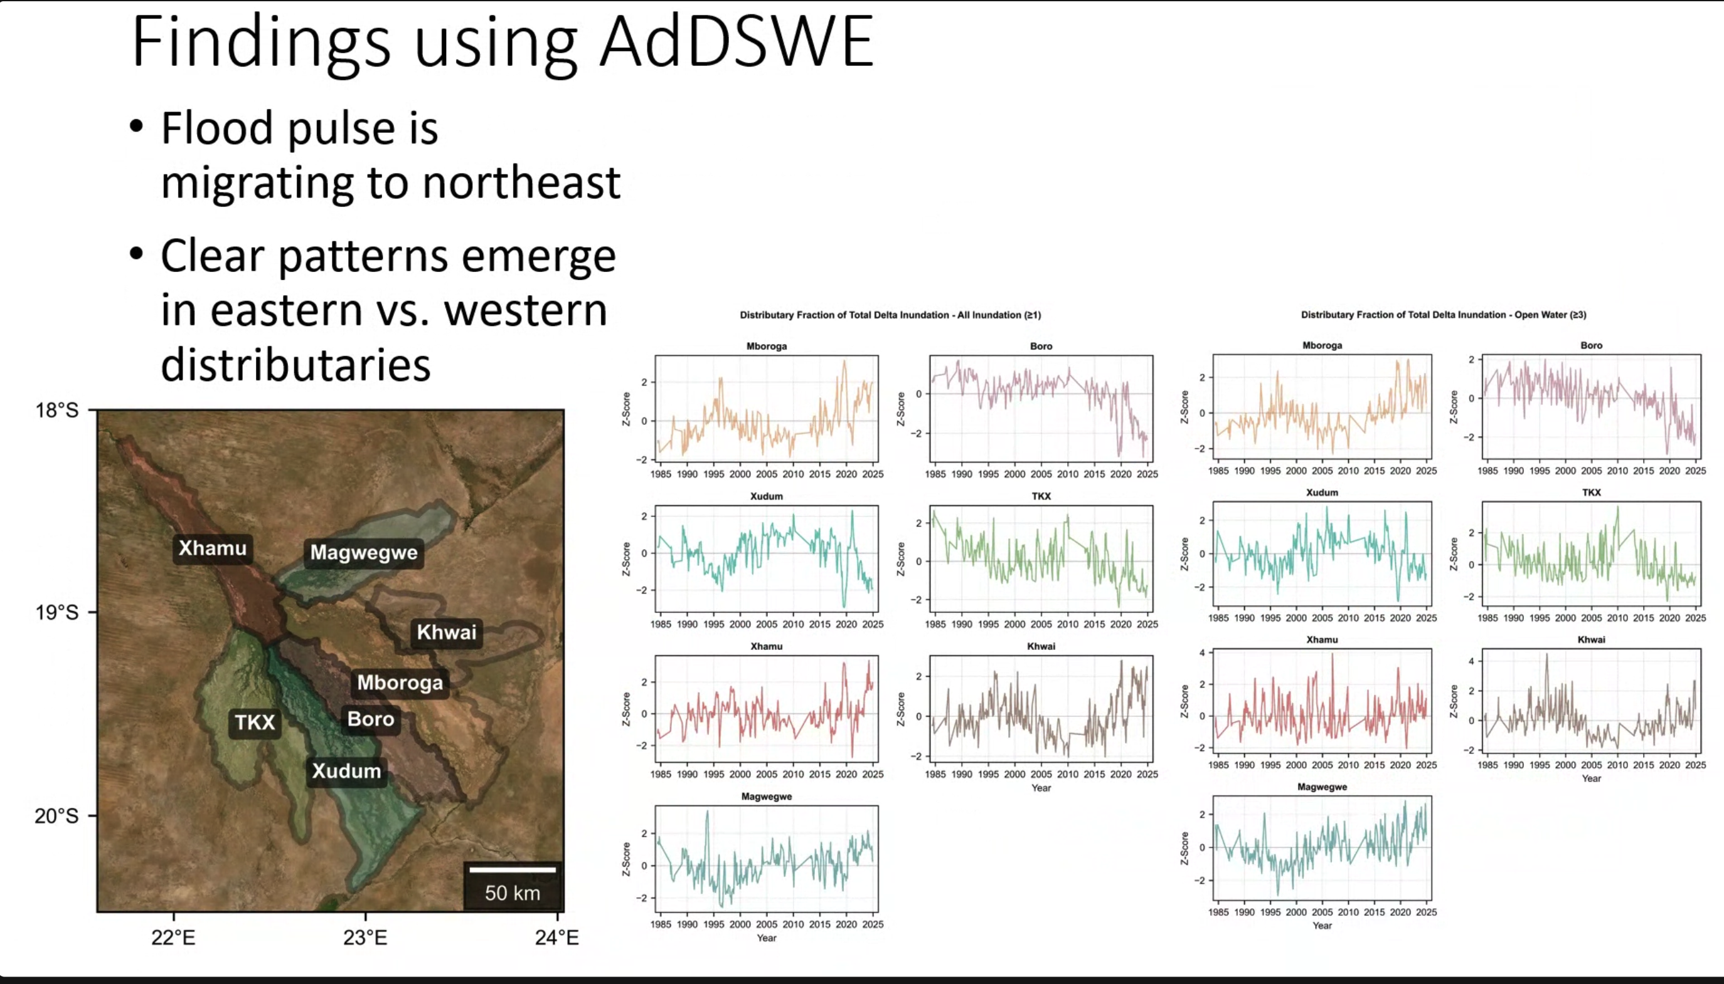

Slide 46
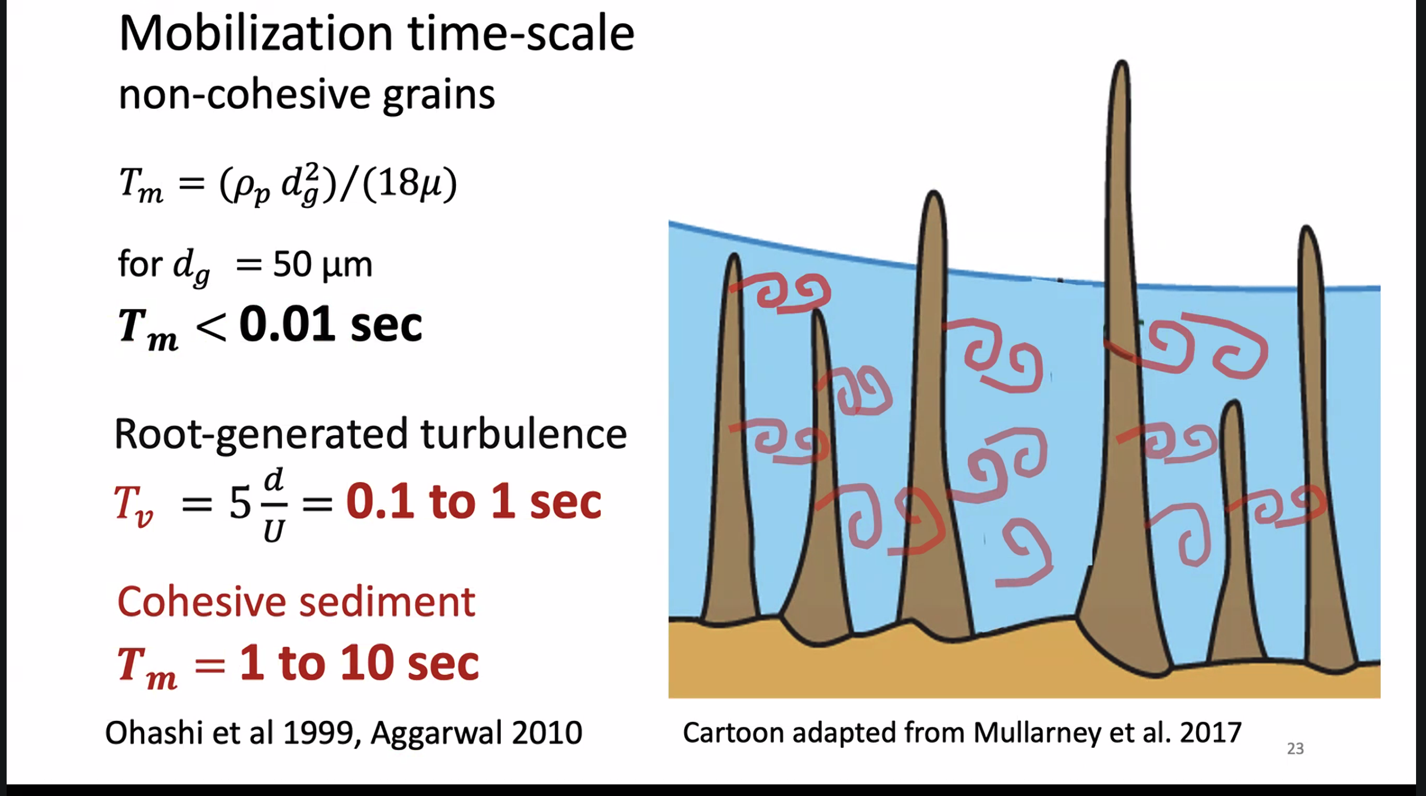

Slide 47
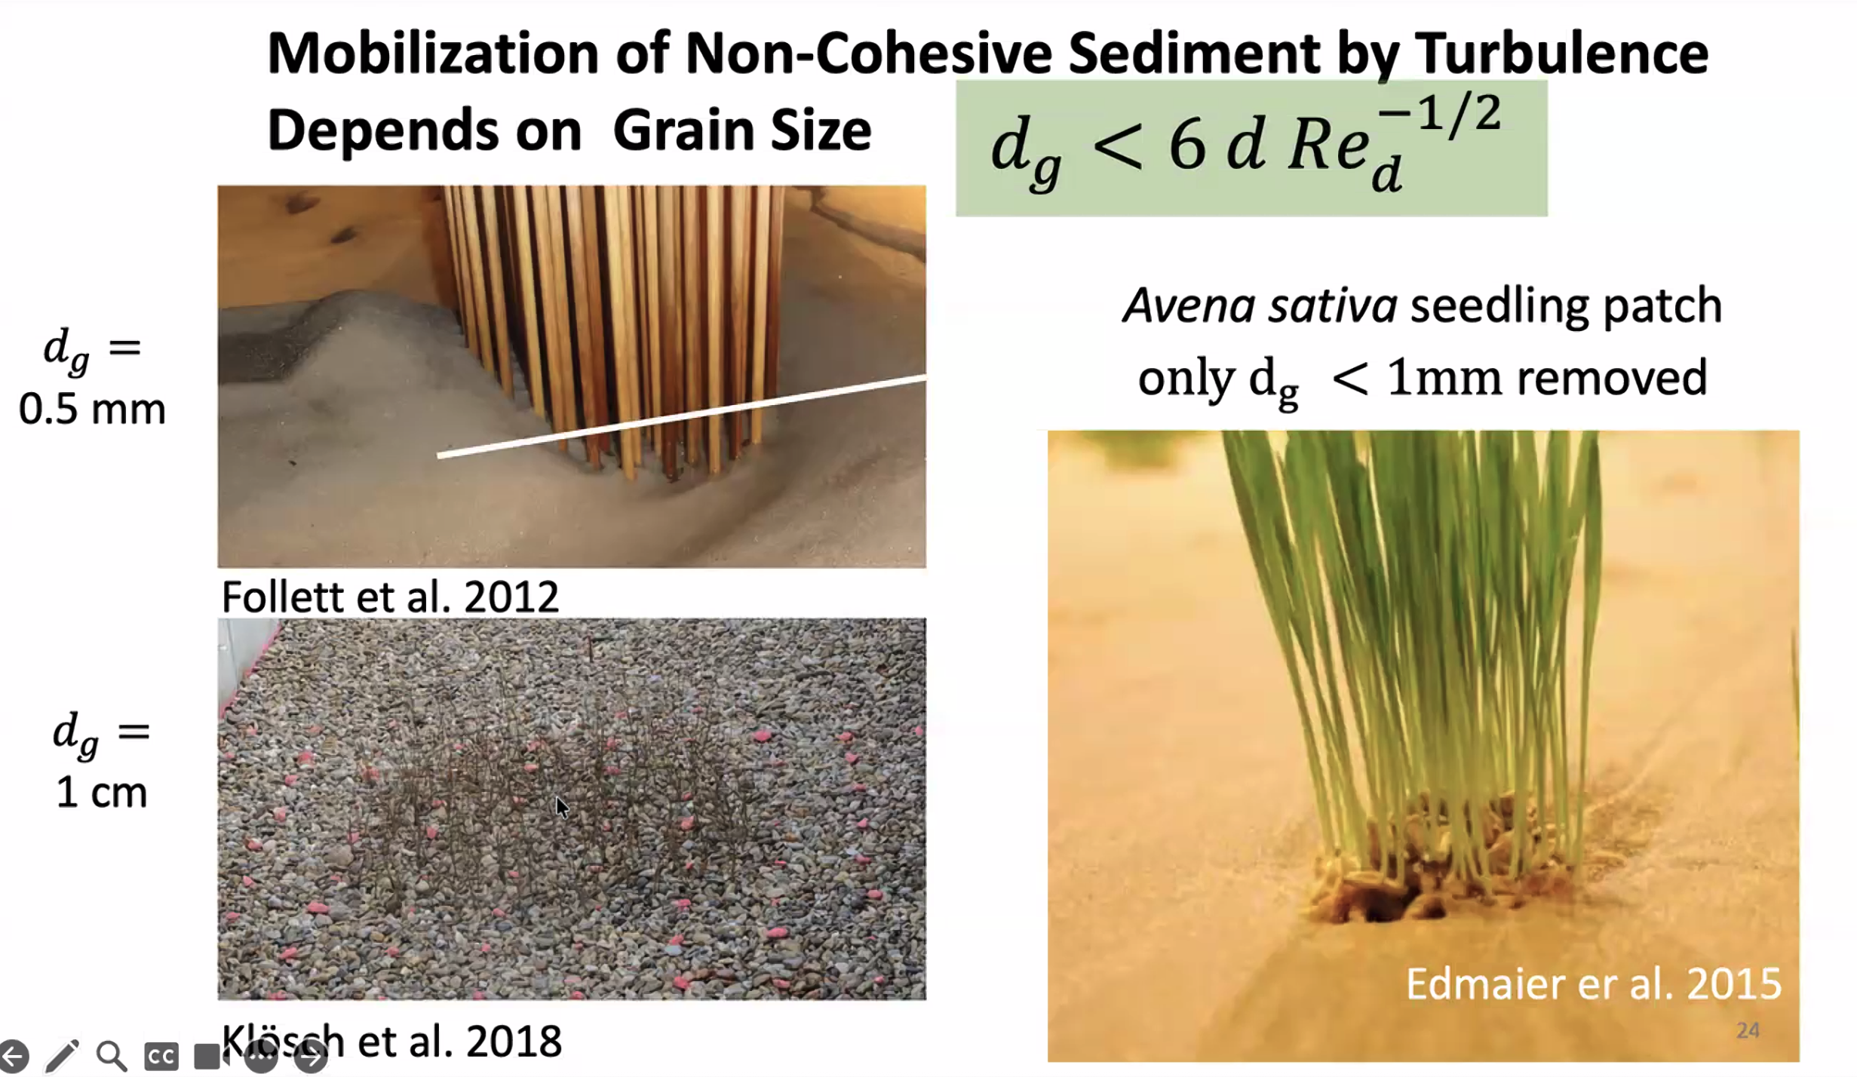

Slide 48
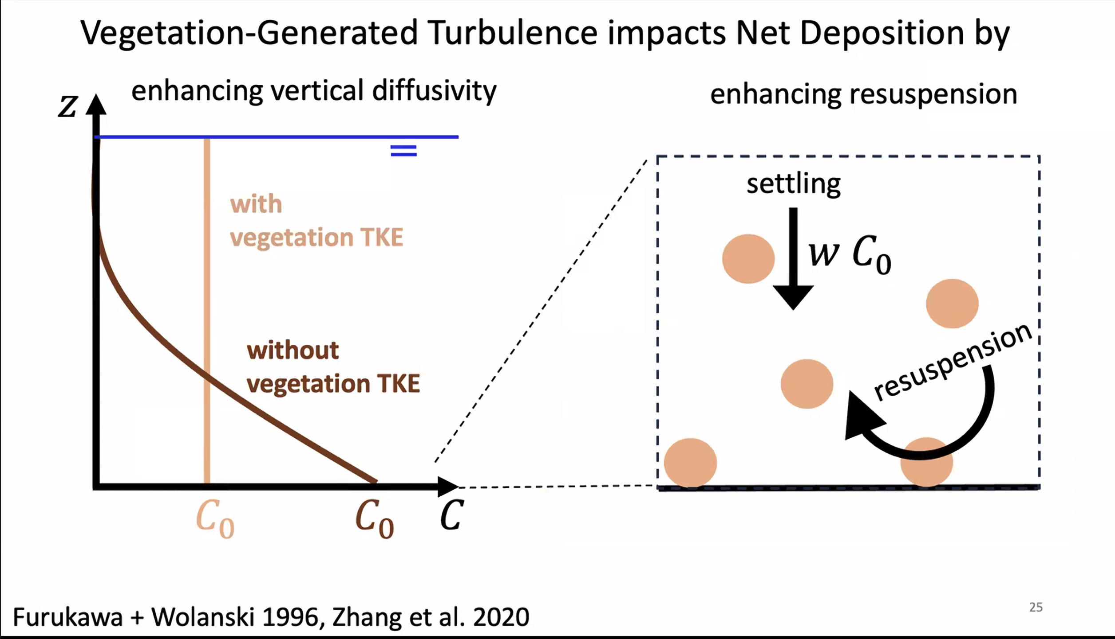

Slide 49
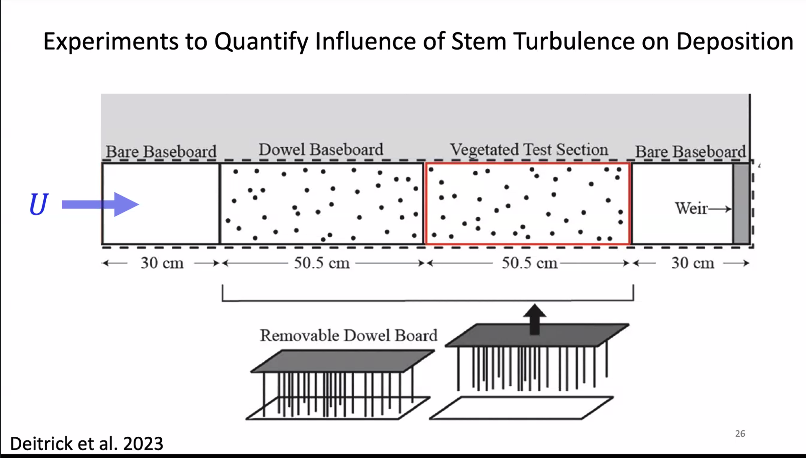

Slide 50
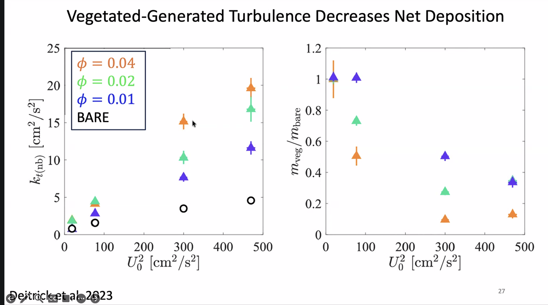

Slide 51
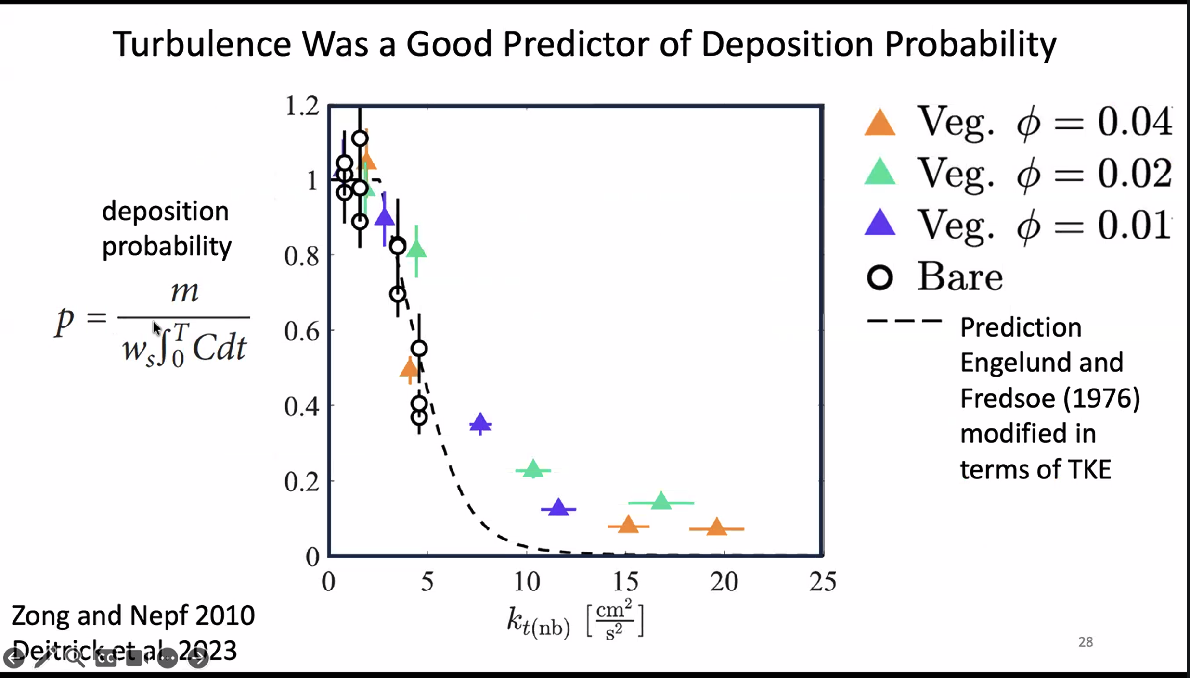

Slide 52
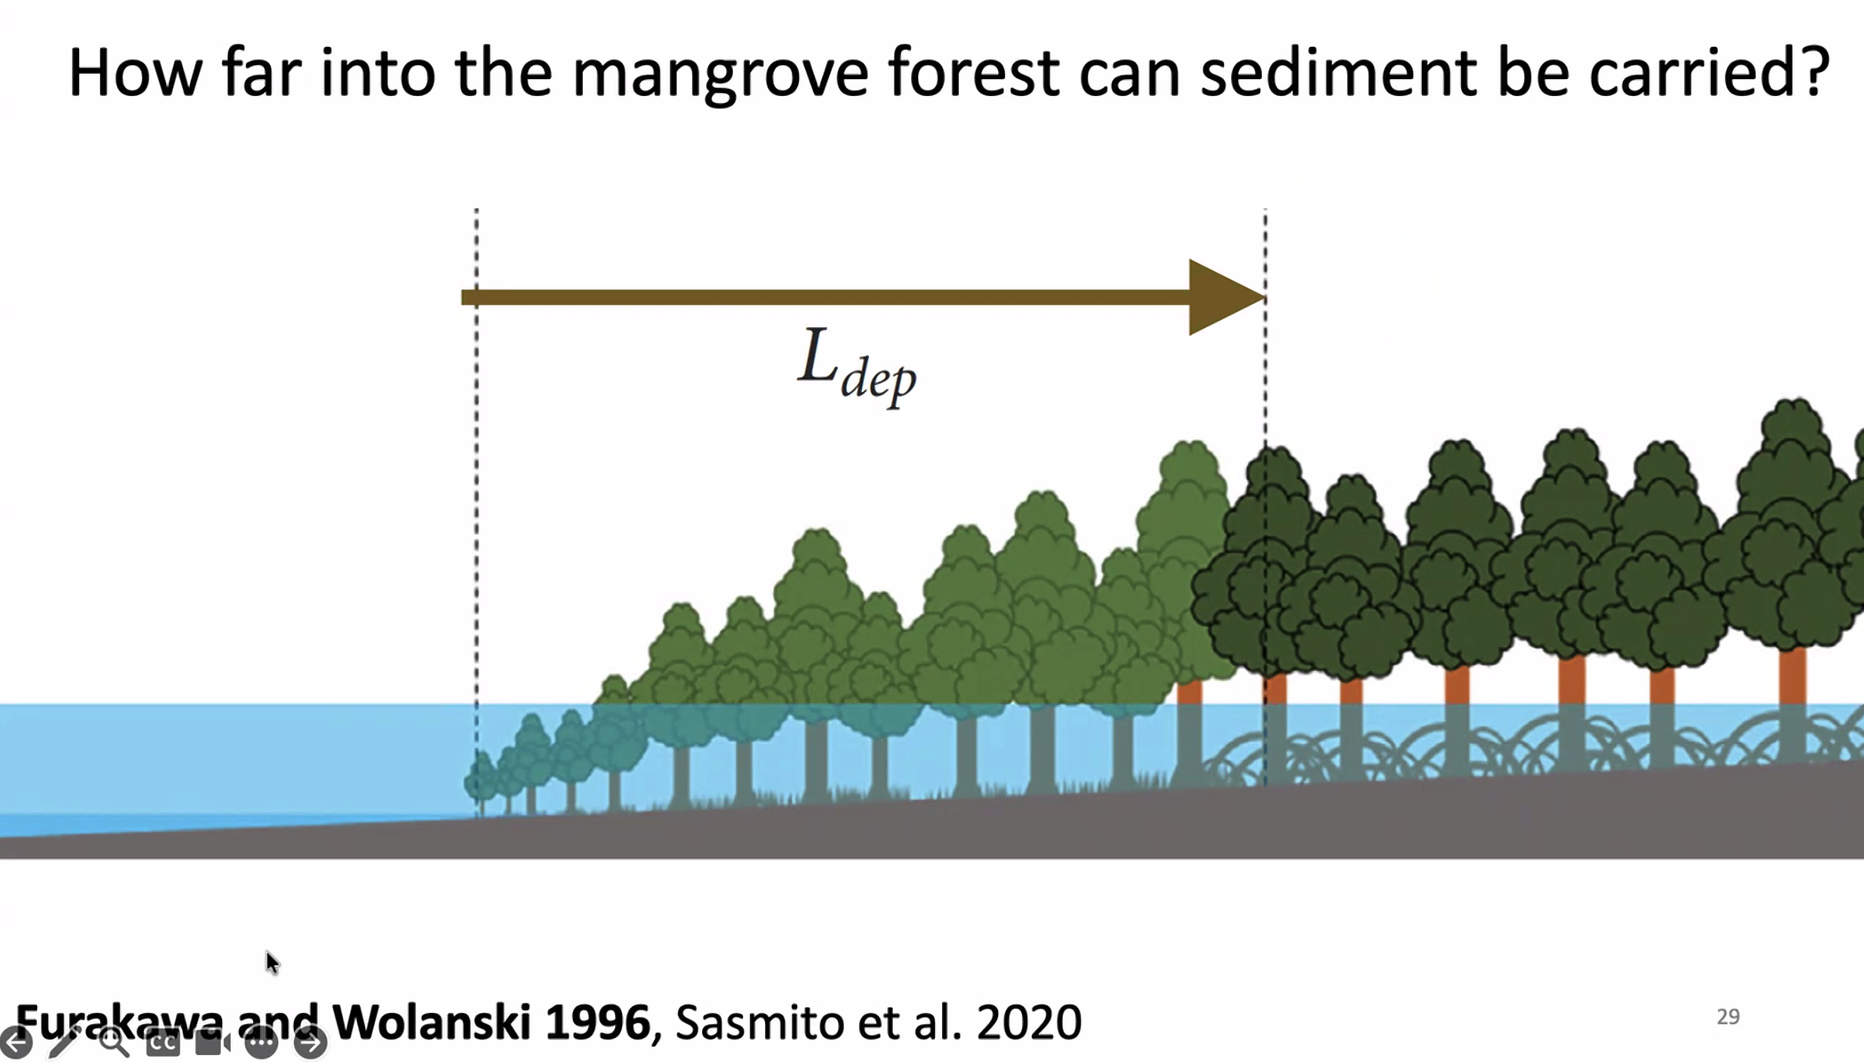

Slide 53


Slide 54


Slide 55


Slide 56


Slide 57


Slide 58


Slide 59


Slide 60


Slide 61


